Slide 1
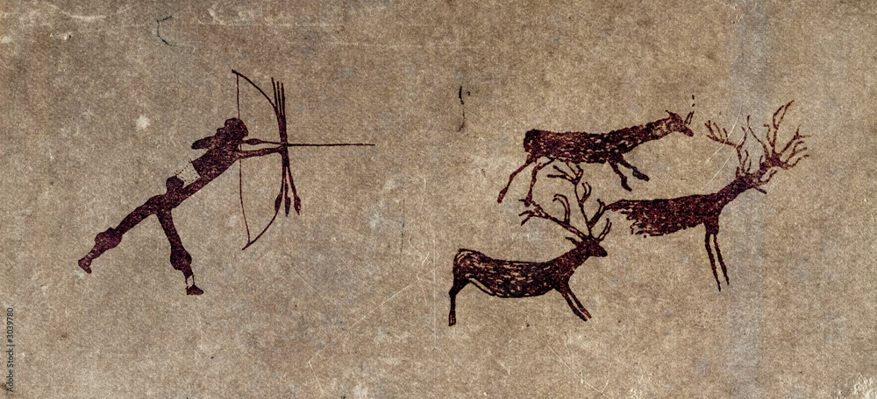
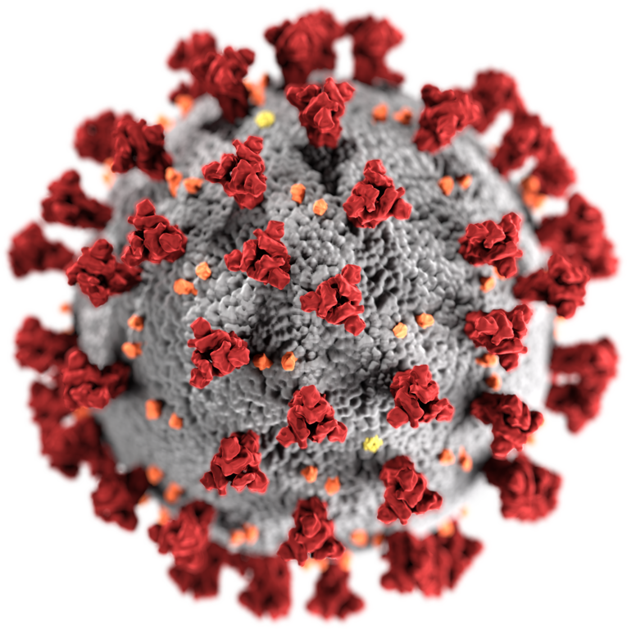
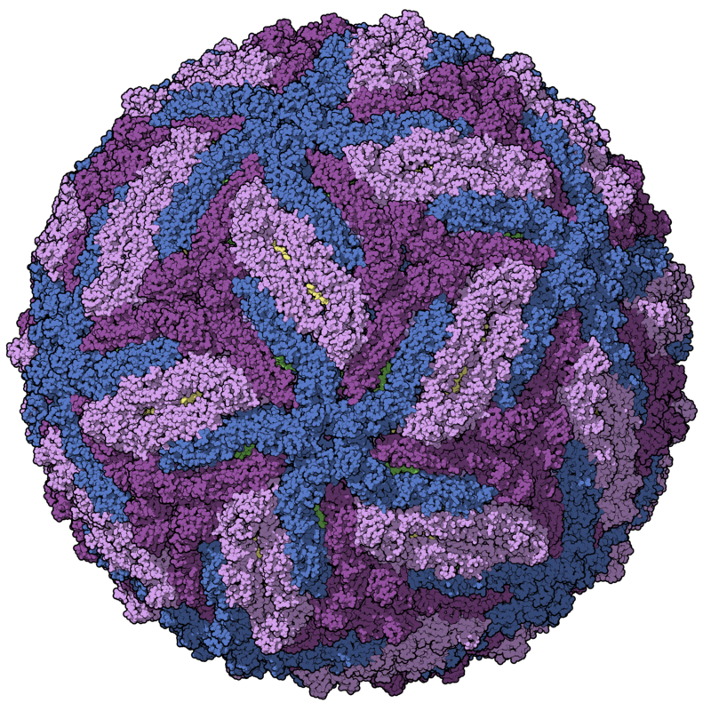
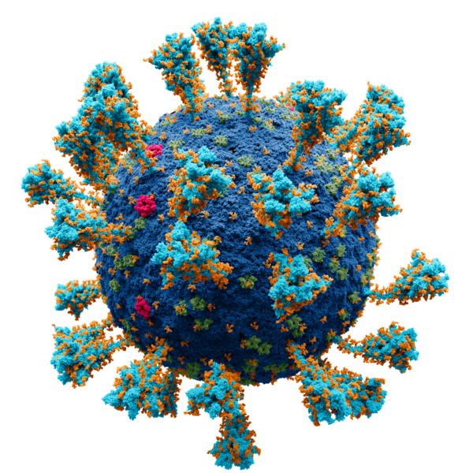
Virome characterisation from unprocessed local and publicly available sequencing data
VirusHunterGatherer and Virusparies
Sergej Ruff
Twincore - RG Computational Virology
29 October 2024
Notes:
Welcome everyone , thank your for coming and listening to the defense of my master thesis .
I chatacterized the virome in unprocessed samples – both local data and downloaded from the internet, using VirusHunter for discovery and Gathrer for assembly.
I also contributed my own application called Virusparies.
Here I want to go into detail. Lets start.

Slide 2
Characterzation of the virome,VirusHunterGatherer and Virusparies - Outline
Introduction
Background: Importance of virus discovery
Goals of my masterś thesis
VirusHunterGatherer and Virusparies
Workflow
Hittables
Virusparies
Taubert
Assembled sequences in mammalian samples
5. Conclusion and outlook
Notes:
Starting with the outline. As you can see it follows the same outline as the master thesis itself.

Slide 3
Introduction
Why do We need virus discovery?
Notes:
I would like to start the introduction by answering the question why we need virus discovery.

Slide 4
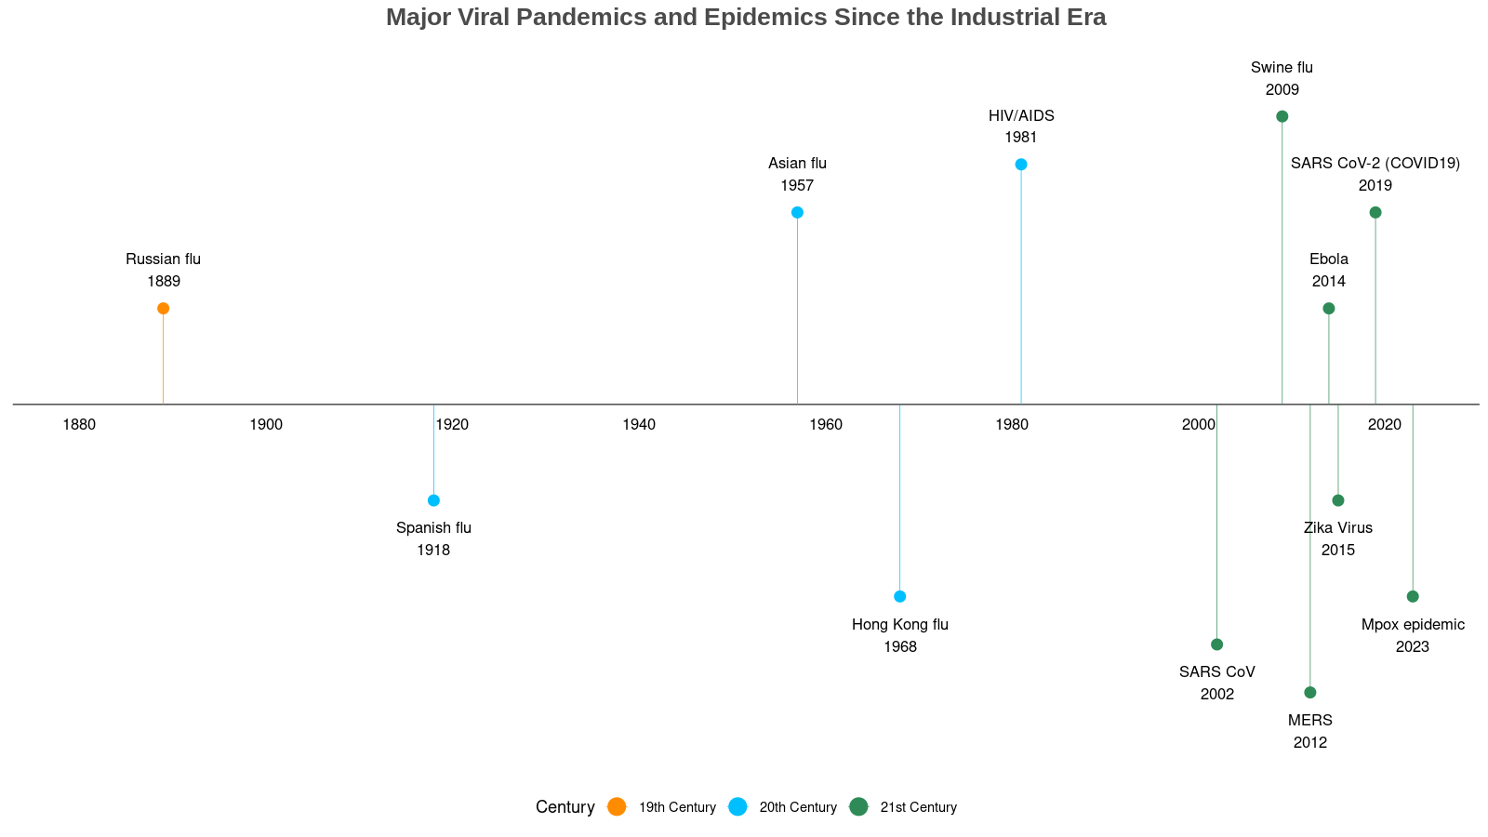
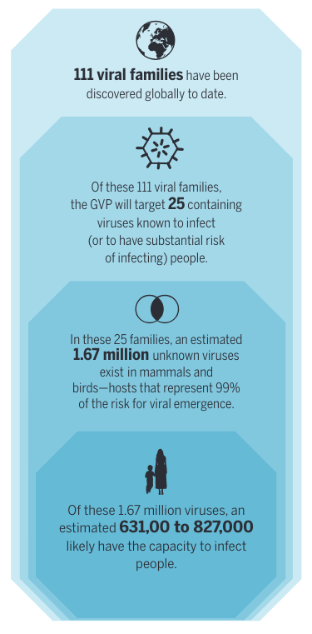
Importance of virus discovery
- Pandemics
Bhadoria P, Gupta G, Agarwal A. Viral Pandemics in the Past Two Decades: An Overview. J Family Med Prim Care. 2021 Aug;10(8):2745-2750. doi: 10.4103/jfmpc.jfmpc_2071_20. Epub 2021 Aug 27. PMID: 34660399; PMCID: PMC8483091.
Carroll D, Daszak P, Wolfe ND, et al. The Global Virome Project. Science.
2018;359(6378):872-874. doi:10.1126/science.aap7463
Notes:
Well, if we look at some of the major epidemics and pandemics since the industrialisation.
Increase in epidemics and pandemics in comparison to the last centrury. Same observation was made by Bhadoria et al.
Pandemics used to occure 1-3 times each century, we saw 6 in this century alone release of the paper we saw the Mpox outbreak. Most being zoonoses coming from mammals and birds.
Reasons: globalisation, increased air traffic and more contact with animals.
Need for virus discovery to understand the diversity of the virosphere to combate the next epidemic
Mention that those are major human pandemics and epidemics.
→ Unterschied zwischen pandemic und epidemic naschauen + die Sachen zu den pandemien wissen
→ Paper lesen.
Dont say, that half of the viruses can infect humans. Hard to believe.
“many are capable to infect humans”.
Or “can be associated with humans through the microbiome”

Slide 5
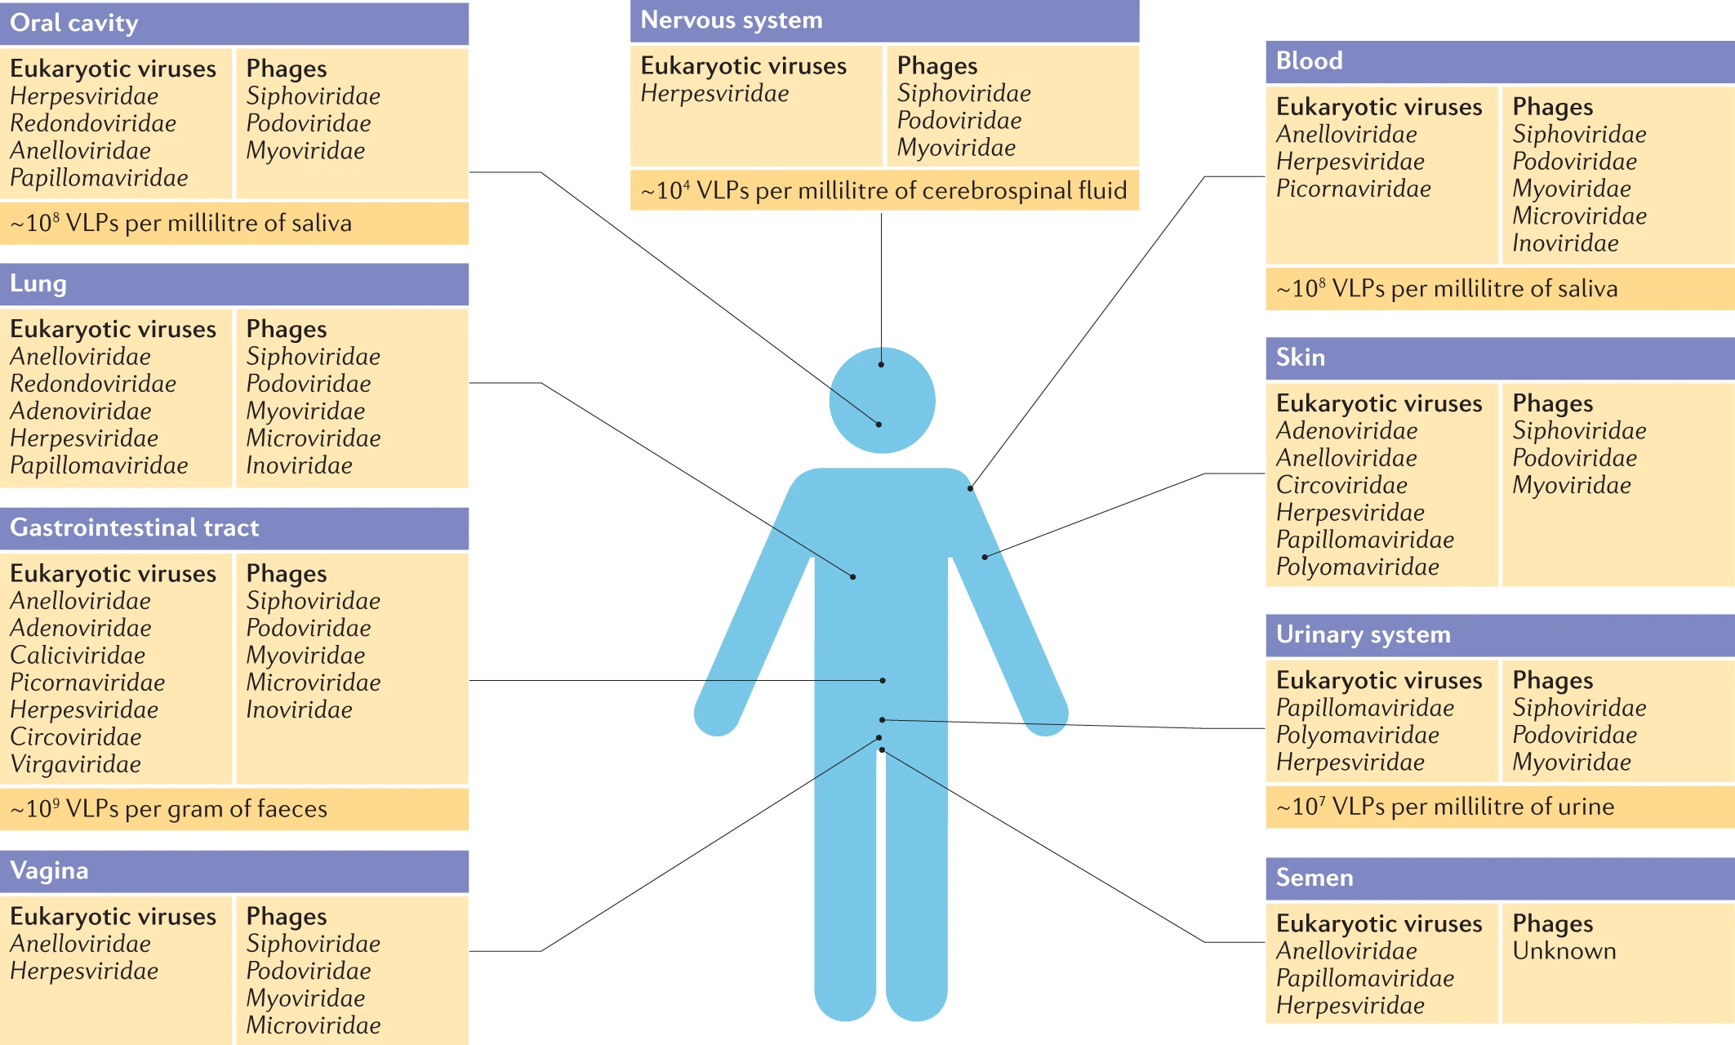
Liang, G., Bushman, F.D. The human virome: assembly, composition and host interactions. Nat Rev Microbiol 19, 514–527 (2021). https://doi.org/10.1038/s41579-021-00536-5
Importance of viral discovery - Virome
approximately 10¹³ particles per human individual.
Infecting our cells and cellular microorganisms.
High heterogeneity across different body sites.
Human endogenous retroviruses (HERV).
Herpesvirus 6.
Anelloviridae.
Notes:
Second reason is the virome.
We all harbor 10¹³ viral particles in us spread with a hight heterogeneity across different body sites.
Some infect our cells, but most infect our microbiota.
Besides the disease causing viruses, there known viruses that contributed positivly to our evolution such as Syncytin retroviral protein contributing to the placenta development. Anneloviridae commensal.
Diversity and complex interactions of the virome are still largely unknown.
Erwähnen, dass es positive, negative und Kommensale gibt
→ Paper lesen.
Stress that this is the humane virome – in title too.
And its association to health and disease.

Slide 6
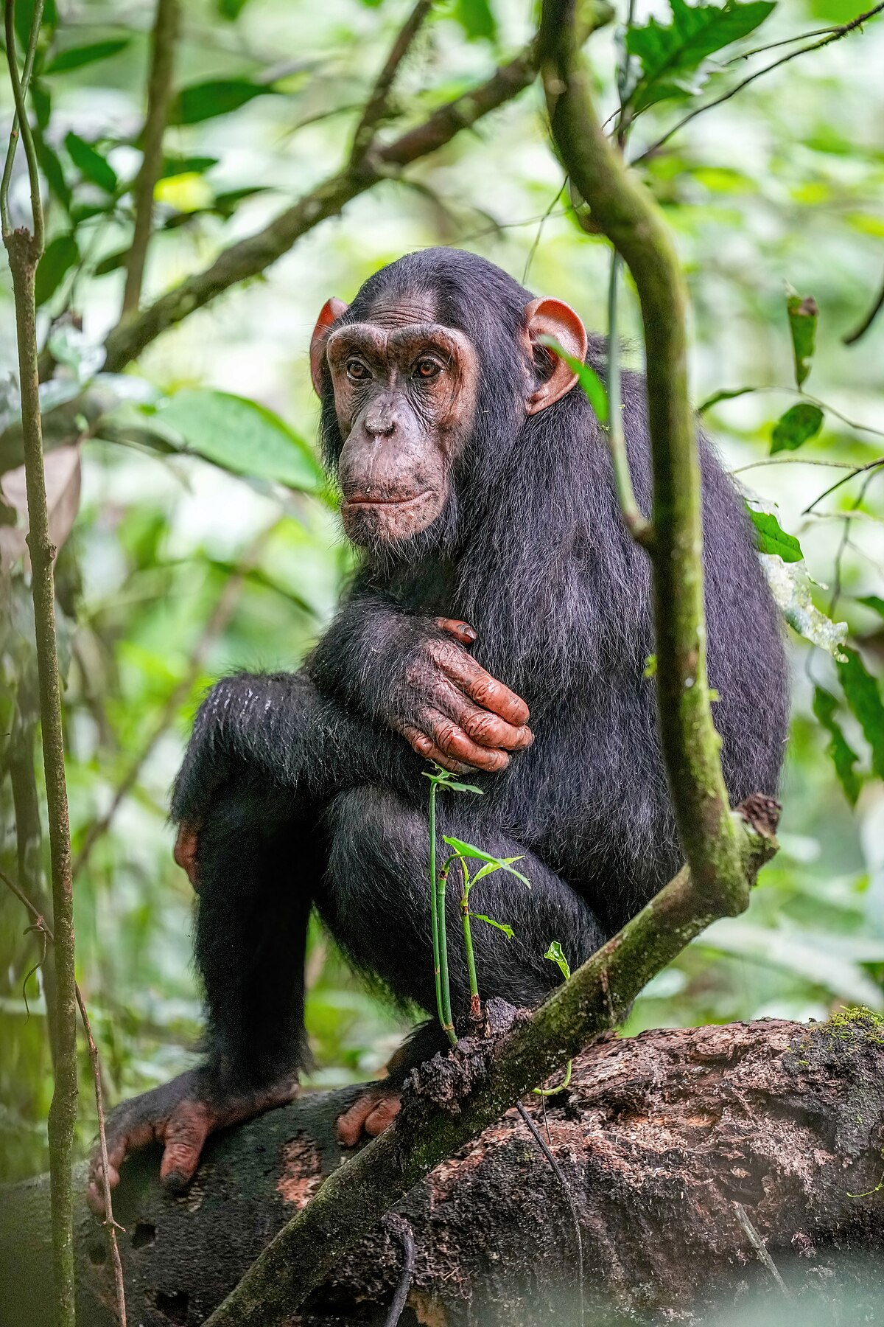

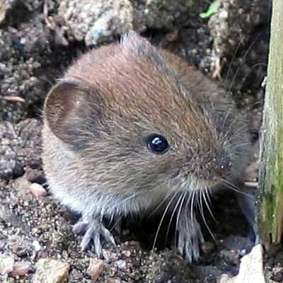
Importance of virus discovery – surrogate viruses and viral history
Endangered!
ssRNA(+) virus
Genus: Hepacivirus
Family: Flaviridae
Phylum: Kitrinoviricota
Surrogate
Pre-2011: hepaciviruses only known in humans and chimpanzees.
Now: new mammalian and non-mammalian hepaciviruses discovered.
Virus discovery
insights into evolution
links to (human) diseases.
surrogate viruses
Approximately 50 million people are living with HCV infection (Global hepatitis report 2024: action for access in low- and middle-incomecountries).
Liver fibrosis.
Hepatocellular carcinoma (HCC) → liver cancer.
Treatment: direct-acting antiviral (DAAs) regimens.
George-
Baker virus
B (GBV-B)
?
Notes:
For the third point
GBV-B is a known virus related to HCV
Value of virus discovery would be if we find a new yet unidentified virus related to HCV, which infects a mammel, that is easy to maintain and use in lab, and that can cause the typical symptoms of HCV infection.
New slide
Virus evolution – Find possible associations to human diseases – surrogate viruses

Slide 7
Goals of my masterś thesis:
Liver Sequencing Data of Patients Post-Transplantation:
Characterize the virome.
Possible associations between identified viruses and transplant rejection?
Mammalian samples:
Assemble potential viral sequences found in mammalian samples.
Functional annotation.
Virusparies

Slide 8
VirusHunterGatherer and Virusparies

Slide 9
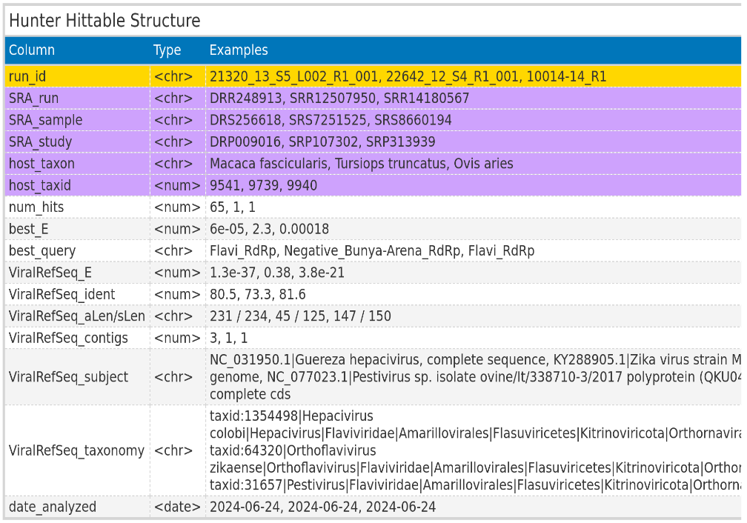
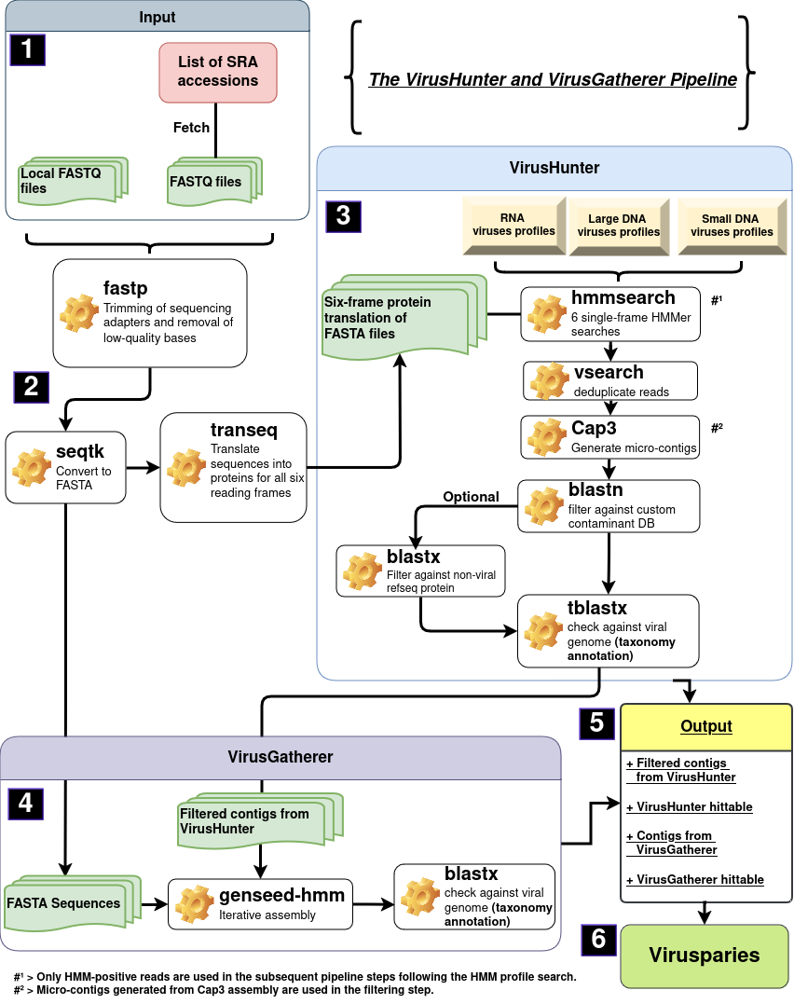
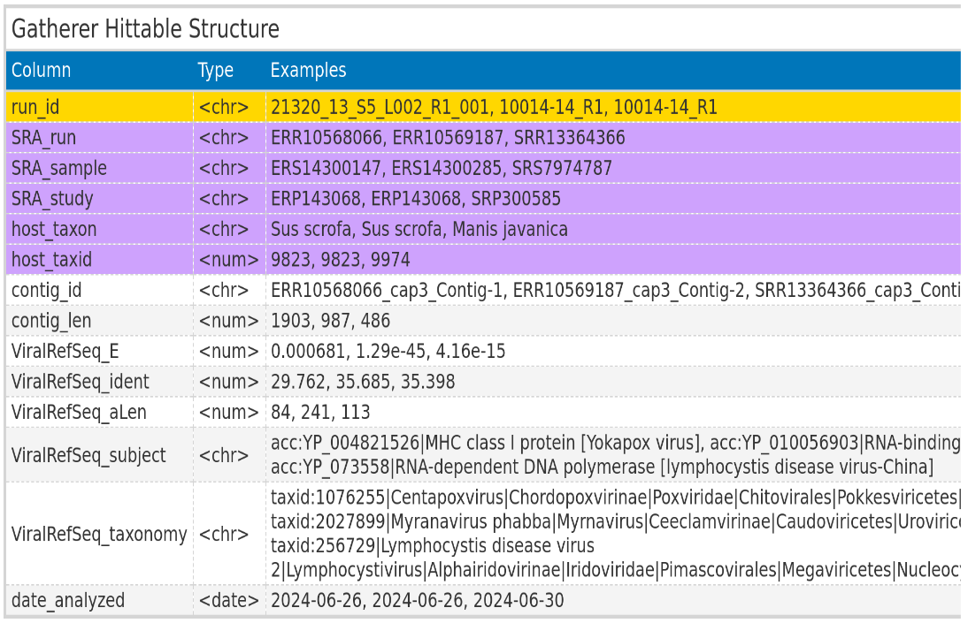
Schematic workflow of VirusHunterGatherer pipeline
Notes:
Mention, that VirusHunterGatherer was available to me. Meaning I apply it, while Virusparies was developed by me.

Slide 10

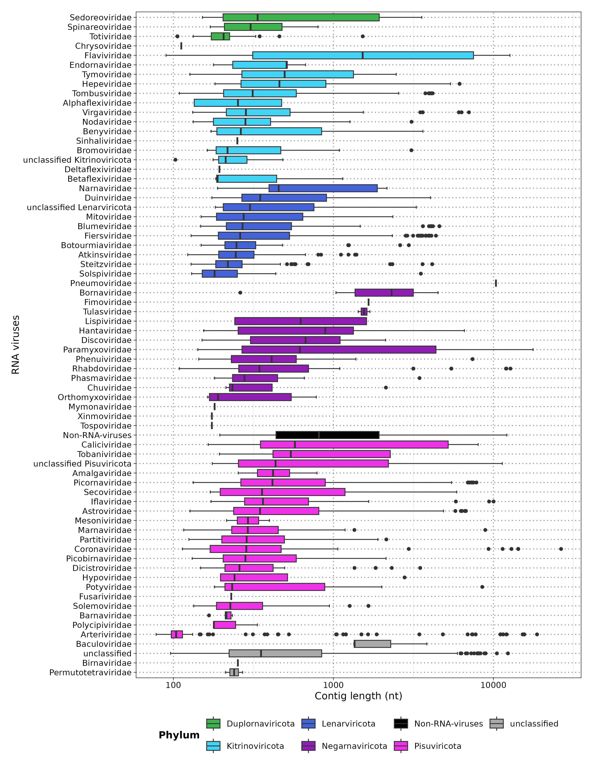
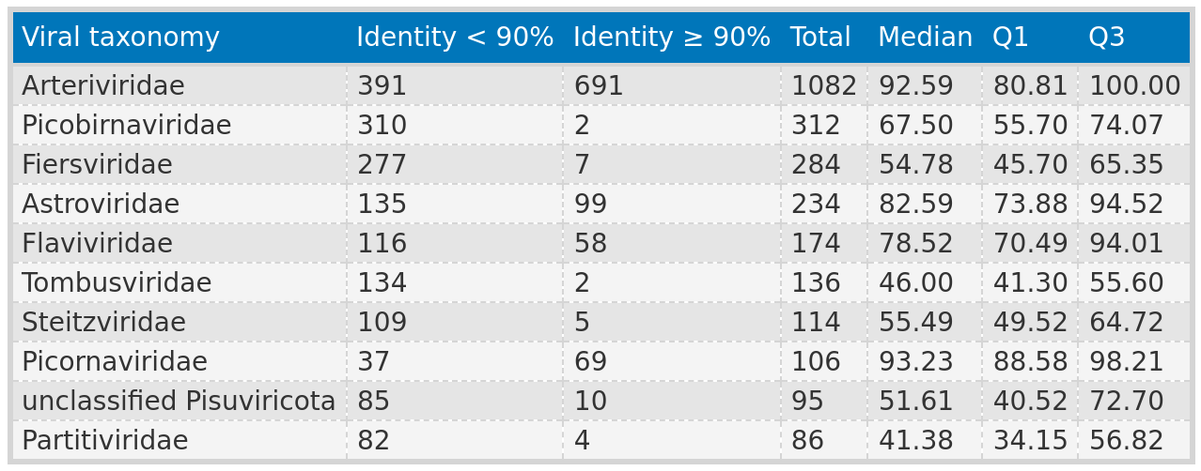
Import/Export
Virusparies
Processing
Summary Statistics
Reports

Slide 11
Taubert data
Taubert – Department of Gastroenterology,Hepatology, Infectious Diseases and Endocrinology.
Local files from Taubert.
Samples: Whole transcriptome sequencing data from liver transplant patient samples.
Notes:
Now lets talk about the first dataset
Taubert research group provided
Local sequencing data
Sequencing data consist of the entire transcriptome found in
Liver transplant patient samples

Slide 12
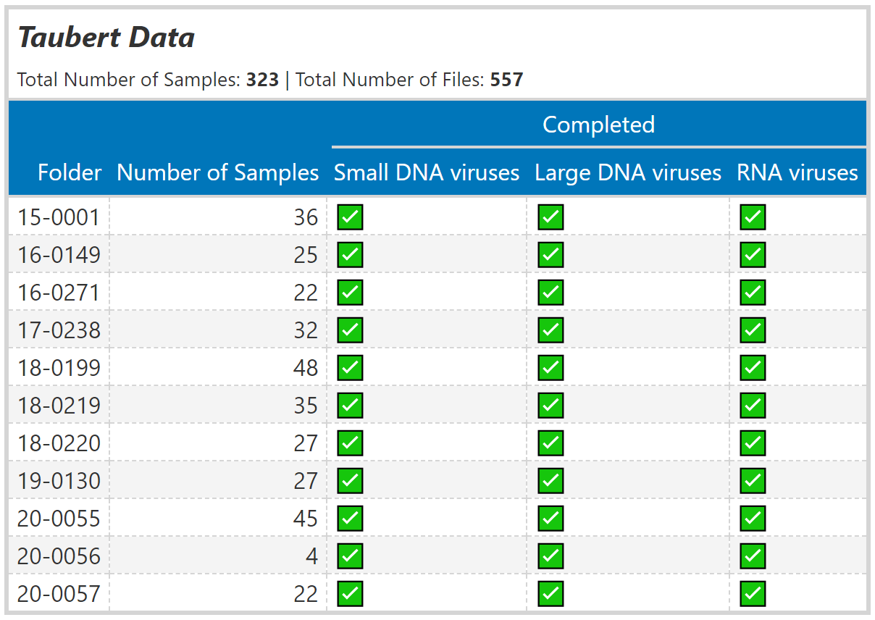
Taubert data – liver sequencing data
Liver samples categorized into groups
No rejection.
T-cell mediated rejection.
Antibody-mediated rejection.
Taubert proposed reasons for liver rejection independent of viruses.
Goal:
Analysis aimed to explore the potential involvement of viruses.
Notes:
So the patients in this dataset underwent a liver transplantation
Some did not reject the liver and some did based on t cell or antibody reaction
323 samples across 557 fastq files
I performed a search for both small and large DNA viruses and RNA viruses
Lets talk about the goal.
Taubert RG is interested in antibody mediated rejection.
And here we want to characterize the virome and
Identify viruses lwith a possible link to liver rejection as another factor

Slide 13
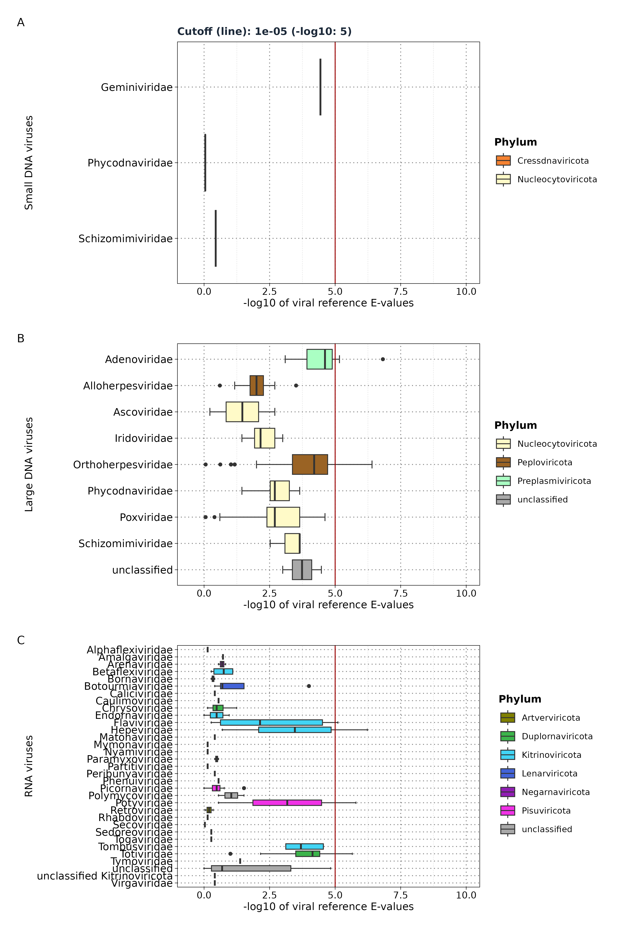
Results: Taubert - Distribution of viral reference
E-values
ViralRefSeq_E < 1e⁻⁵
Liver sequencing data: 557 FASTQ files
VirusHunter
Screening for ...
Small DNA Viruses
Files with no hits: 552 (99.11%); 5 files
Samples: 4
Large DNA Viruses
Files with no hits: 392 (70.38%); 165 files
Samples: 142
RNA Viruses
Files with no hits: 540 (96.95%); 17 files
Samples: 13
Total number of files without hits: 337 (67.68%);180 files
Notes:
So i screen the samples utilizing VirusHunter
- First discovery: The majority of FASTQ files and samples did not return viral hits
The largest number of samples being 142 out of 323.
With a maximum of 31 families.
However those are all hits regardless of significance.
I mentioned that we utilize the E-value from the taxonomy search to define significance.
Here I ued a cutoff of 1e-5.

Slide 14
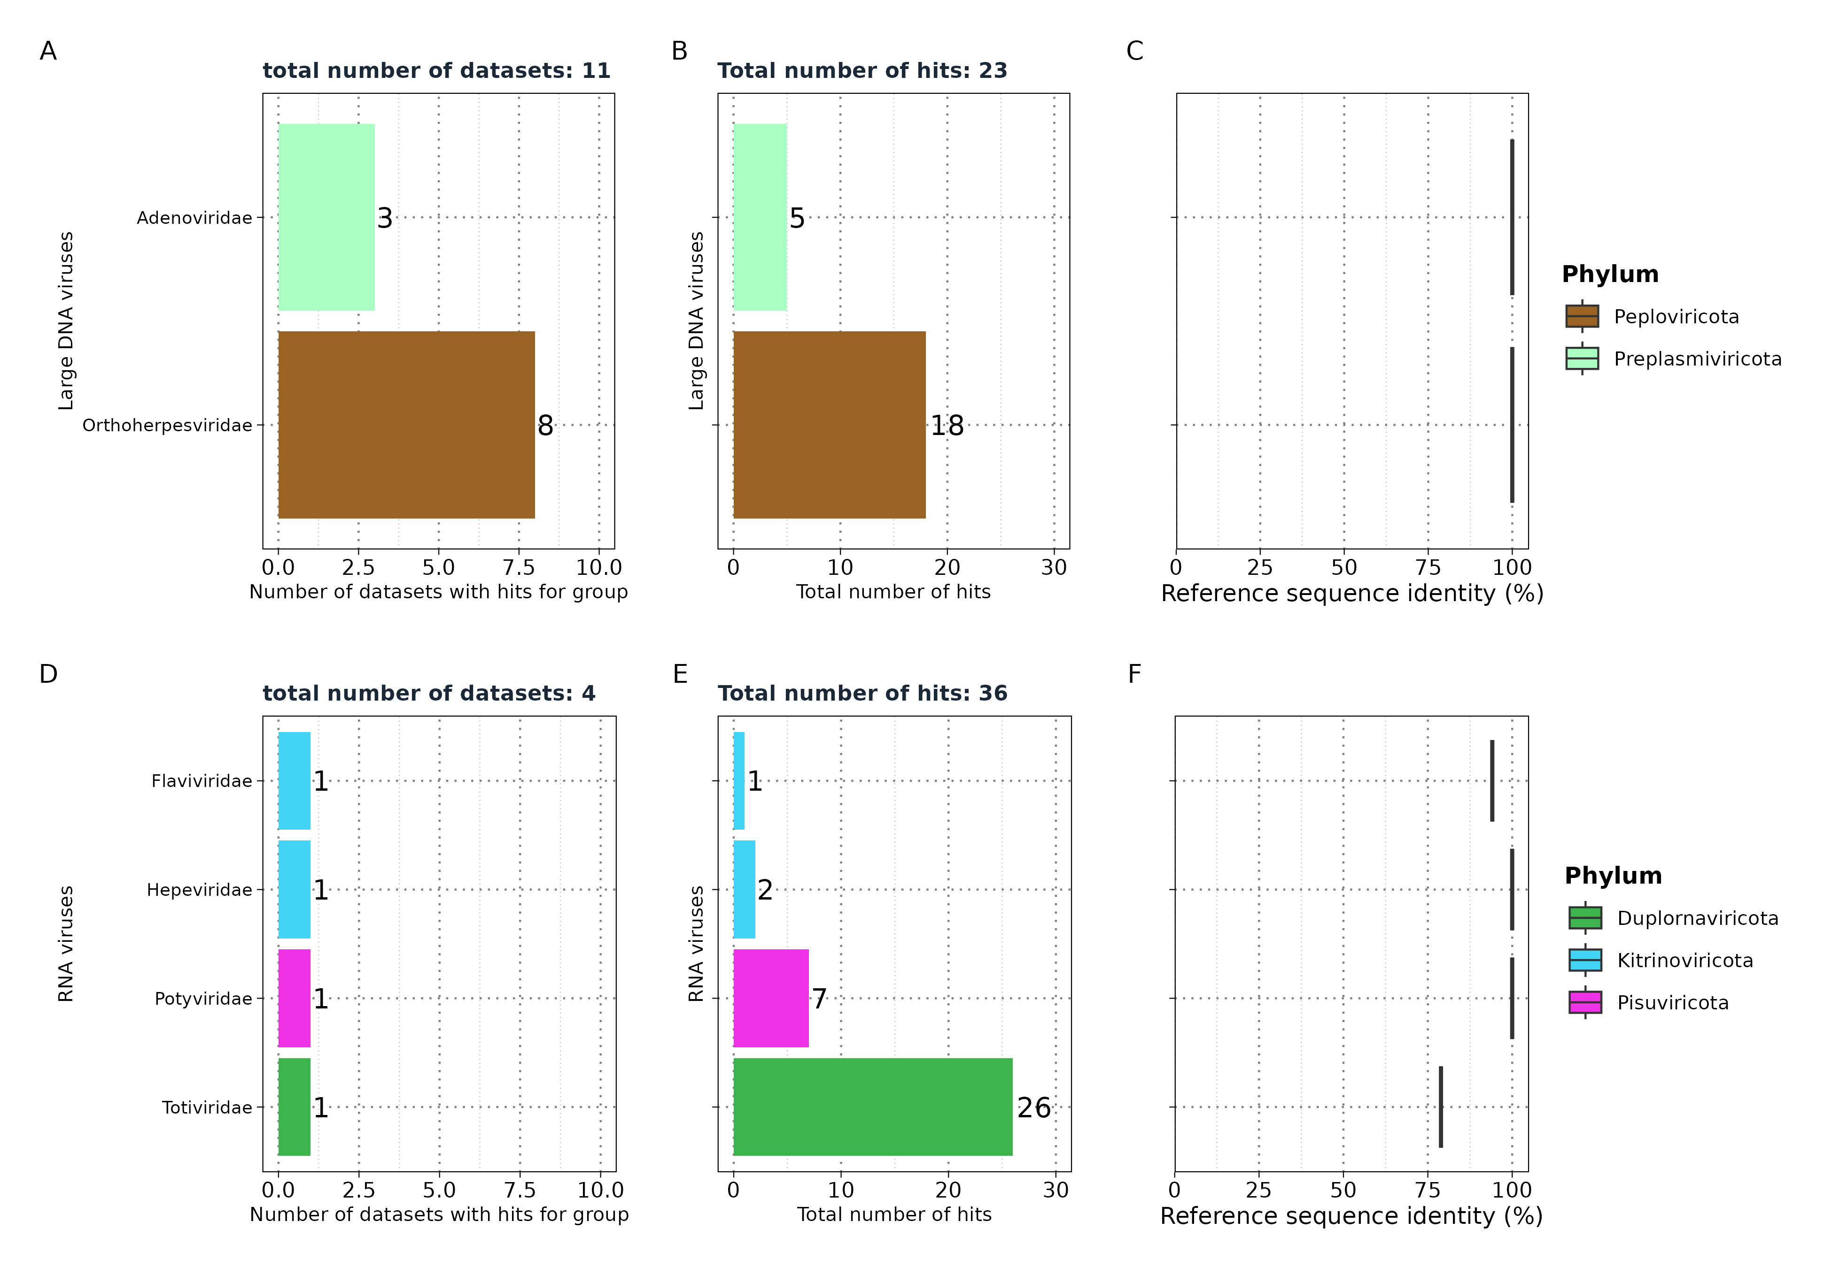
Results: Taubert
significant hits in
VirusHunter
Notes:
If we look only at the significant hits.
Only large DNA and RNA viruses returned any significant hits, but
Only for contigs aligning to 6 families with a maximum number of datasets being 11.
Meaning, We find significant hist only in a small portion of data.
The reads coverage was also small, with a maximum of 36 reads for RNA víruses
And 23 for large DNA
Those micor-contigs had a high similariyt with the closest virus.

Slide 15
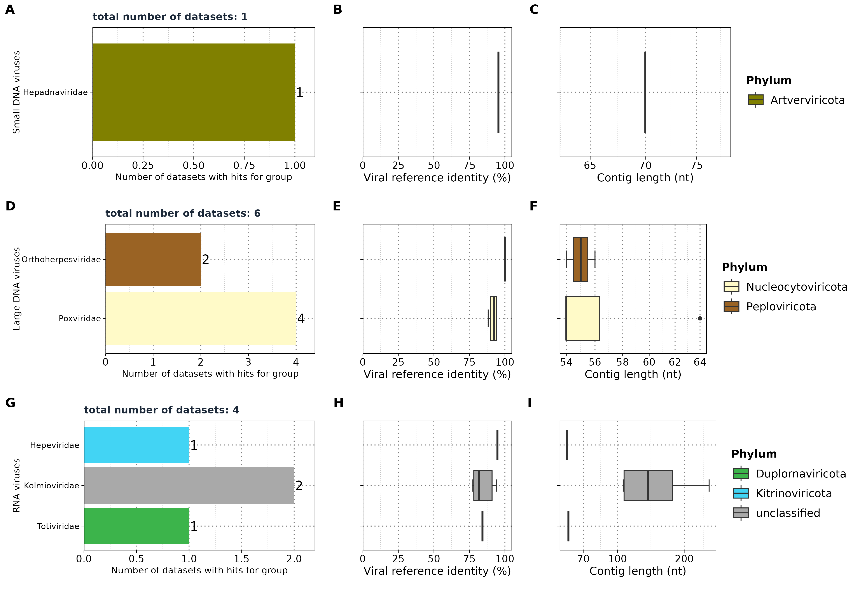
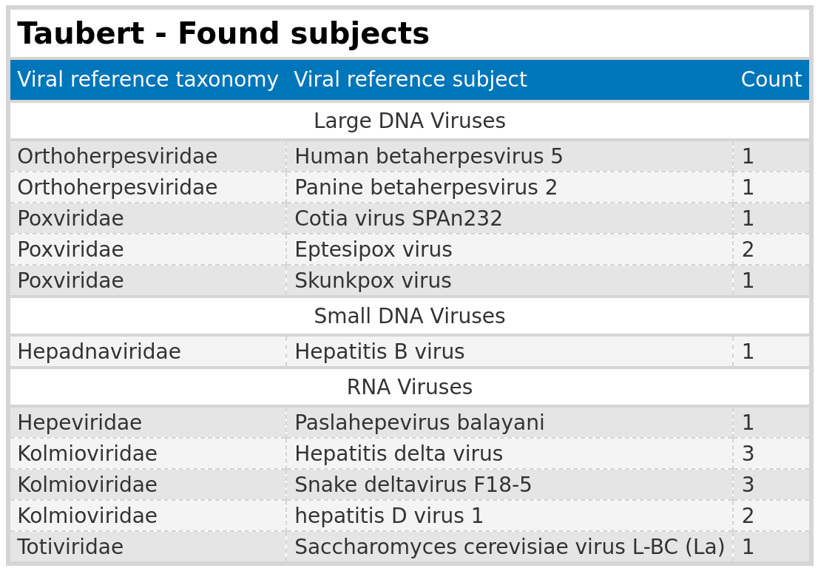
Results: Taubert
VirusGatherer
Liver sequencing data: 557 FASTQ files
VirusHunter
VirusGatherer
Notes:
Used micro-contigs for longer assembly in VirusGatherer.
We see that we are missing some contigs from VirusHunter in Gatherer,
But we also identify alignmenst to new viral families such as Poxviridae, Kolmo and Hepa.
That interesting because those contain also Hepatistis D and B viruses,
However those hits were considered non significant in Hunter, and appear only here because
The internal cutoff of Gatherer is smaller.
We also get only a few contigs in said groups and only contigs with a length below 300.

Slide 16
Results: Taubert
Summary
Analysis summary: Completed analysis of Taubert data for small DNA, large DNA, and RNA viruses.
Data overview: Out of 323 samples, only a small portion returned assembled contigs.
Significance threshold: Significant results were close to the E-value cutoff of 1e-5.
Contig lengths: Identified contigs were all below 300 nt.
No conclusive evidence links viral infections to liver rejection.
Notes:
There is no conclusive evidence
Findings suggest that their no evidence for involvement of viruses in the rejection of liver
We can conclude that viruses did not play a major role if a rejection occurred.

Slide 17
Mammalian data
SRA IDs re-examined from existing hittable.
RNA viruses only.
Notes:
The next dataset is the public one.
Here I got an existing VirusHunter dataset, where virus discovery was already performed.

Slide 18
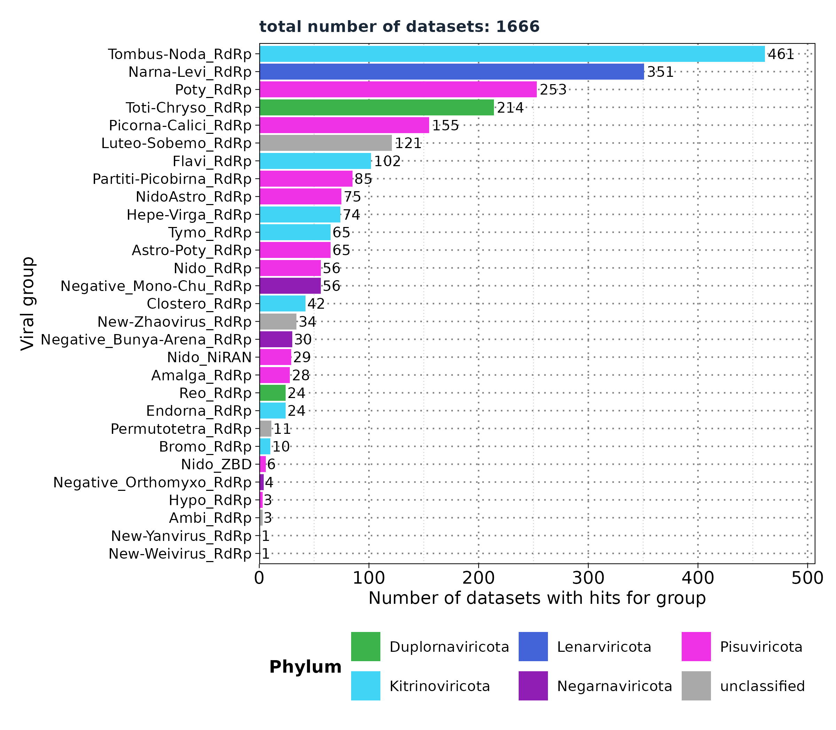
VirusHunter - Screening for RNA viruses in mammalian SRA data
Selected groups:
Flavi (RdRp)
Hepe-Virga (RdRp)
Nido (RdRp,NiRAN)
Negative: Bunya-Arena (RdRp)
Negative: Mono-Chu (RdRp)
Negative: Orthomyxo (RdRp)
Existing Hittable:
34.337 unique SRA Ids
Filtered based on:
'num_hits' > 4
'ViralRefSeq_E' < 1e-5
'ViralRefSeq_ident' < 90
Goal:
Assembly of viral contigs.
Notes:
The goal here is to assembled longer contigs for
Teh discovered viral reads as it hasent been done before.

Slide 19
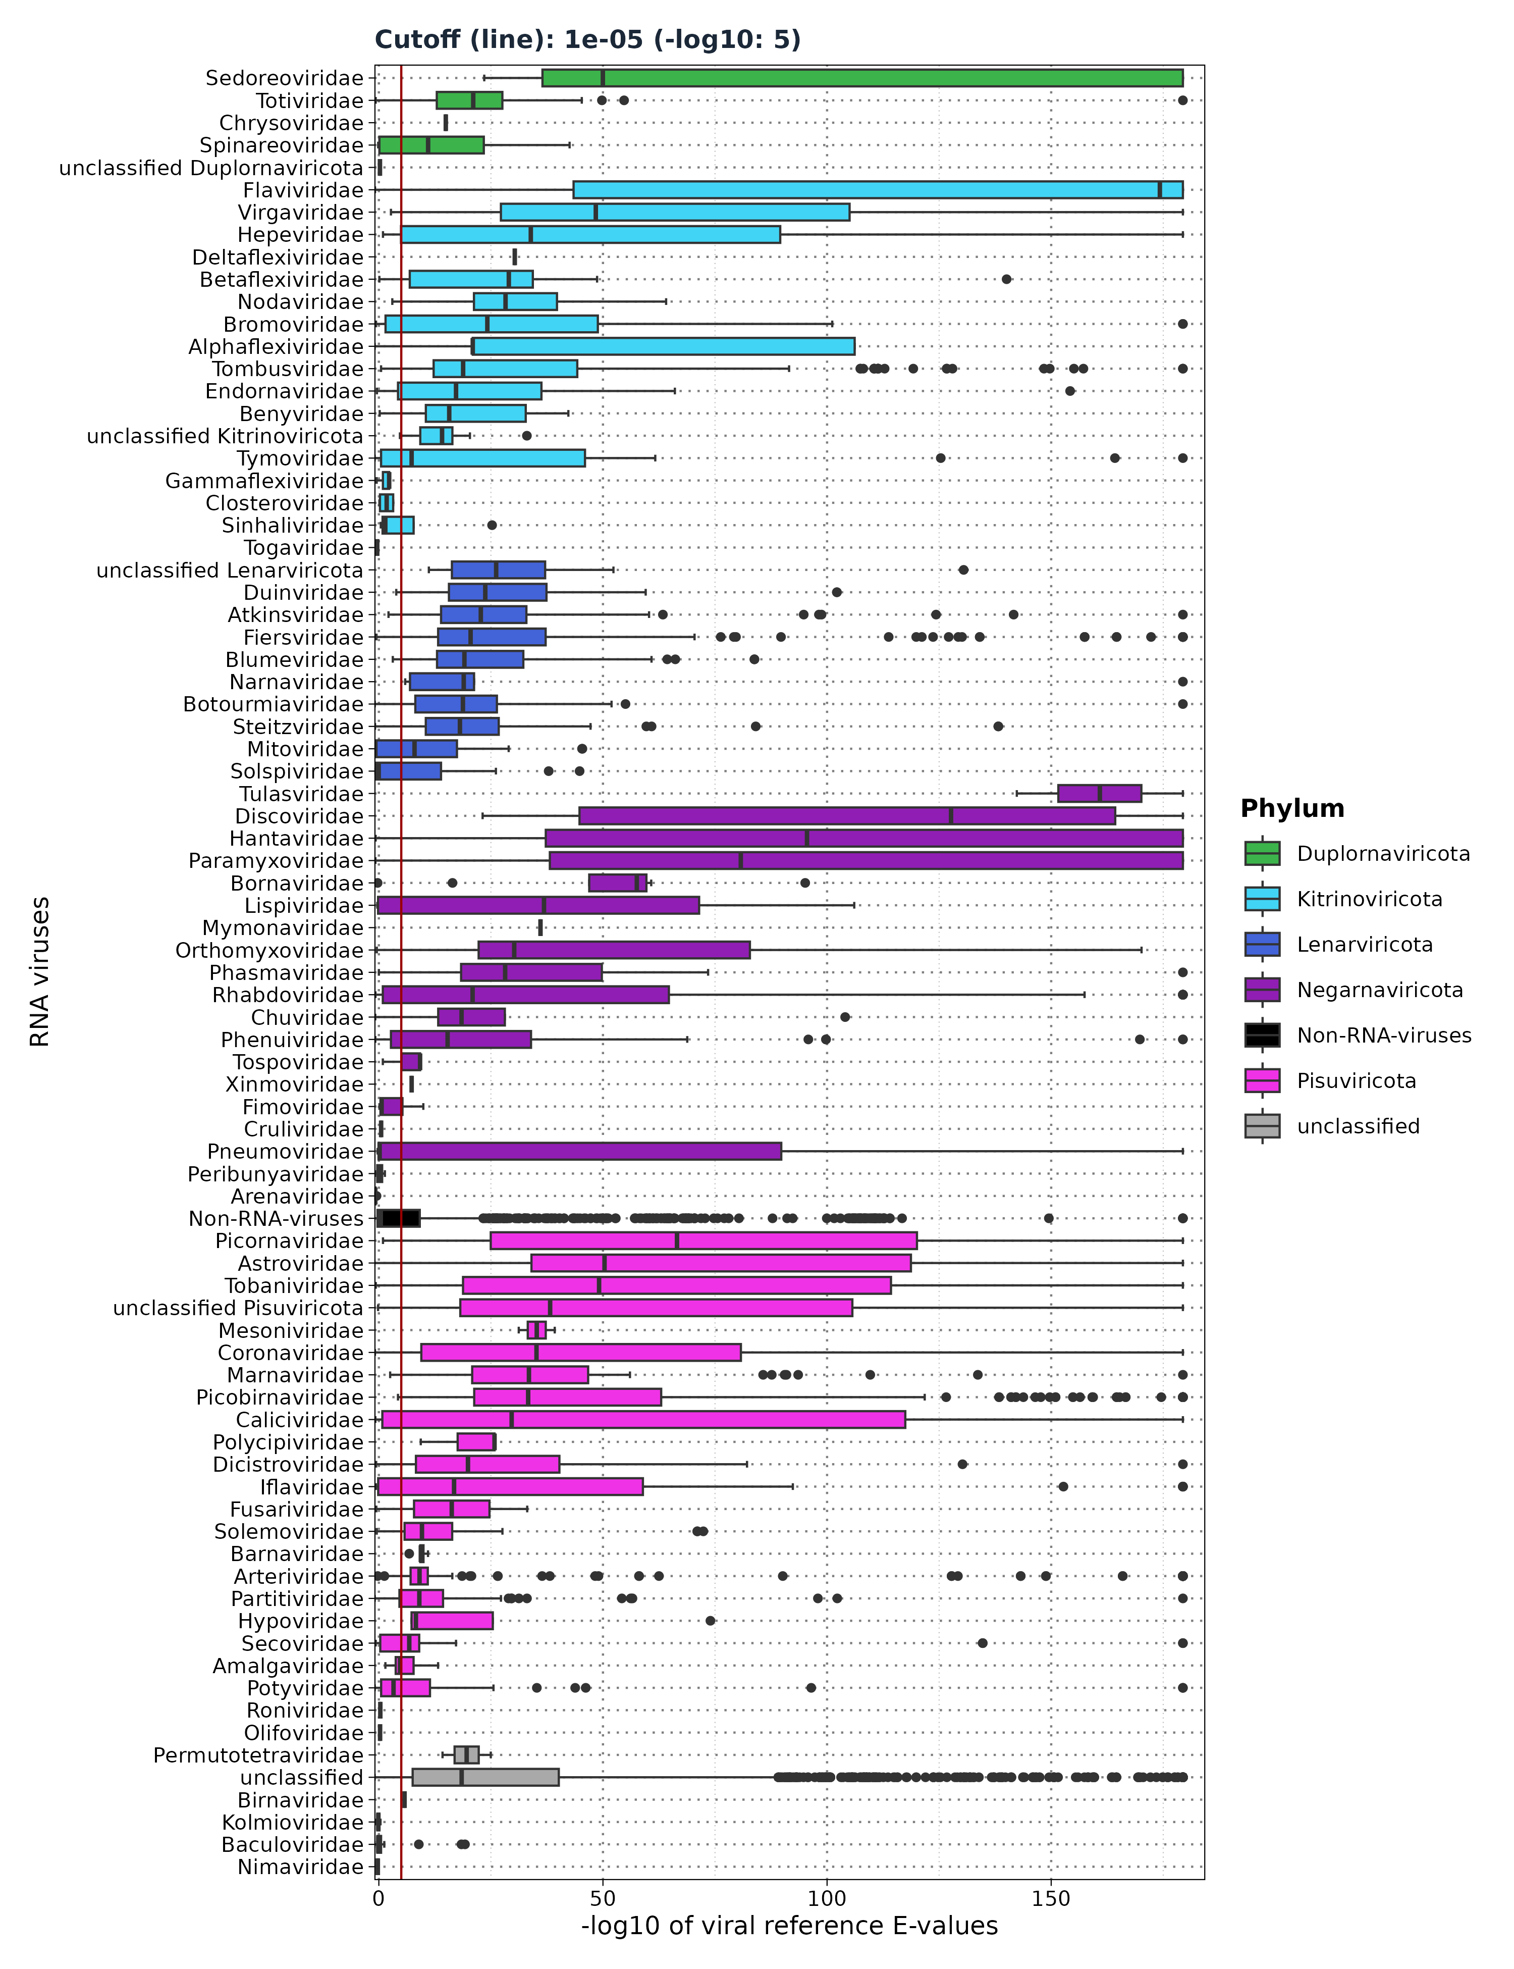
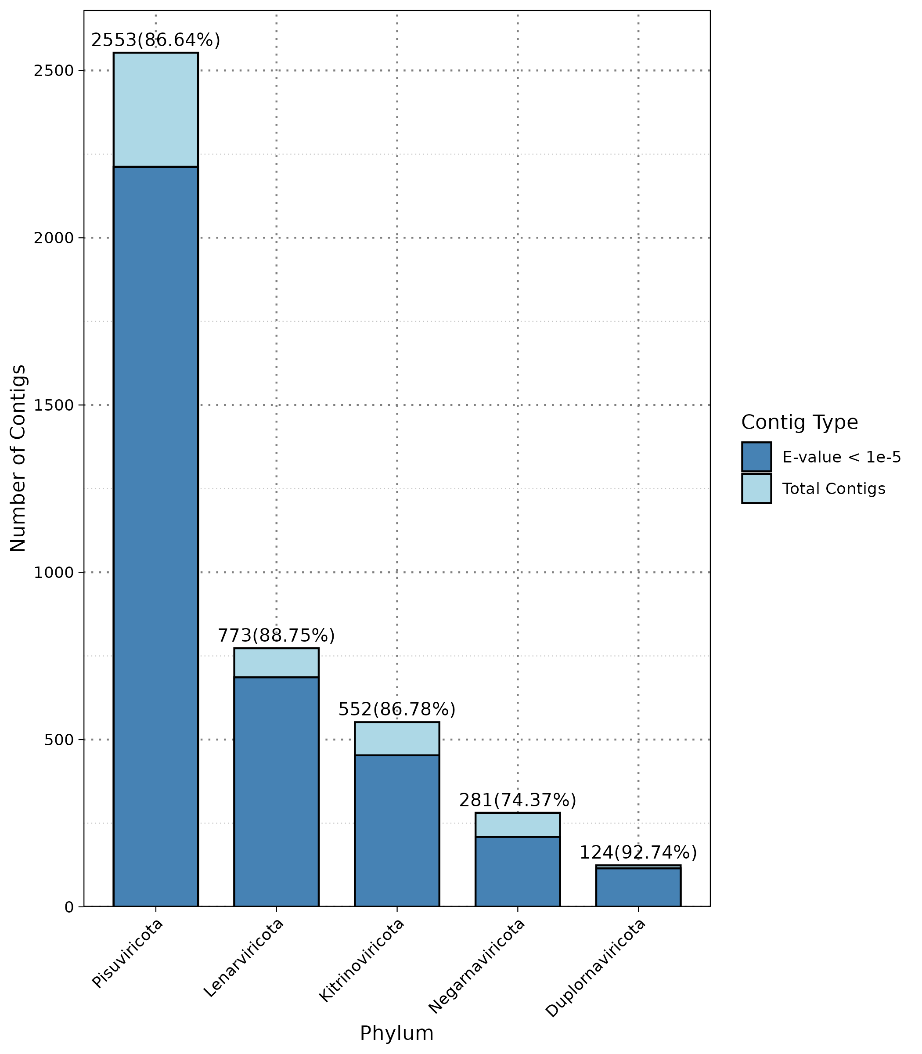
Results: Mammalian – Distribution of viral
reference E-values
VirusHunter
19,113 micro-contigs
VirusGatherer
ViralRefSeq_E < 1e⁻⁵
Assembly returned ...
Total Contigs Assembled: 8,232
Aligned to Viral Families: 128 families + 6 unclassified
High-confidence Alignments: 6,209 contigs with E-values < 1e⁻⁵
Notes:
Here you see the distribution of E-values for the assembled contigs In Gatherer.
Assembled over 8000 contigs aligning to over 120 families.
The majority of them were significant – over 6000 contigs.
If we look at the viral phyla, we see that 3 phyla dominate here.
Pisuviricota being the most dominant with 2500 contigs out ouf 8000 with 86% being significant.

Slide 20
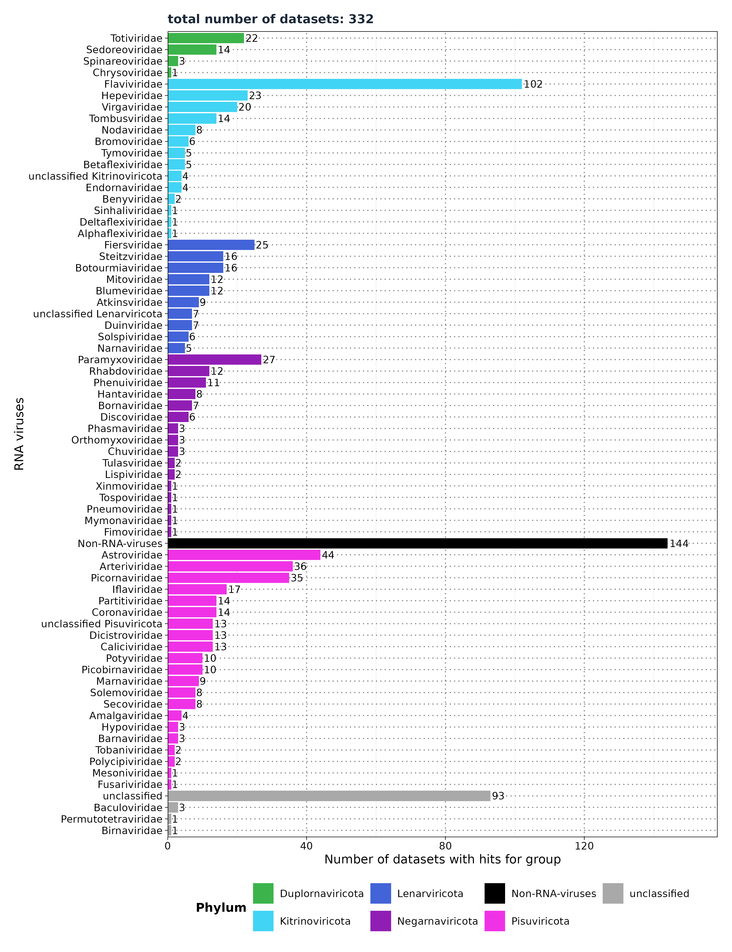
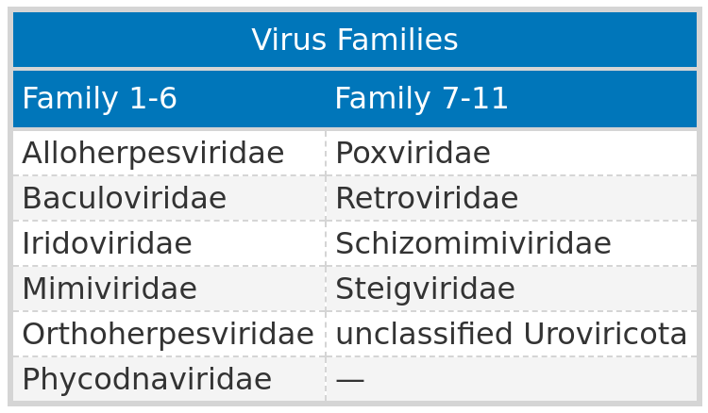
Results: Mammalian - Number of datasets with
viral hits
VirusGatherer
Filter ViralRefSeq_E < 1e⁻⁵
Viral Reference E-values
Non-RNA viruses: 0.37 (IQR: 7.41e⁻¹⁰ to 1.99)
RNA viruses: 1.34e⁻¹⁵ (IQR: 9.74e⁻³⁹ to 2.85e⁻⁷)
Notes:
Here we can see that we found viral contigs in 332 studies.
The highest diversity of viruses being Pisvirocta
And 102 studies containg Flaviviridae, then
Astroviridae, Arteriviridae and Picornaviridae.
144 studies identified Non-RNA viruses, which are largely DNA viruses,
However those false positives as their E-value is smaller than those from the RNA viruses.

Slide 21
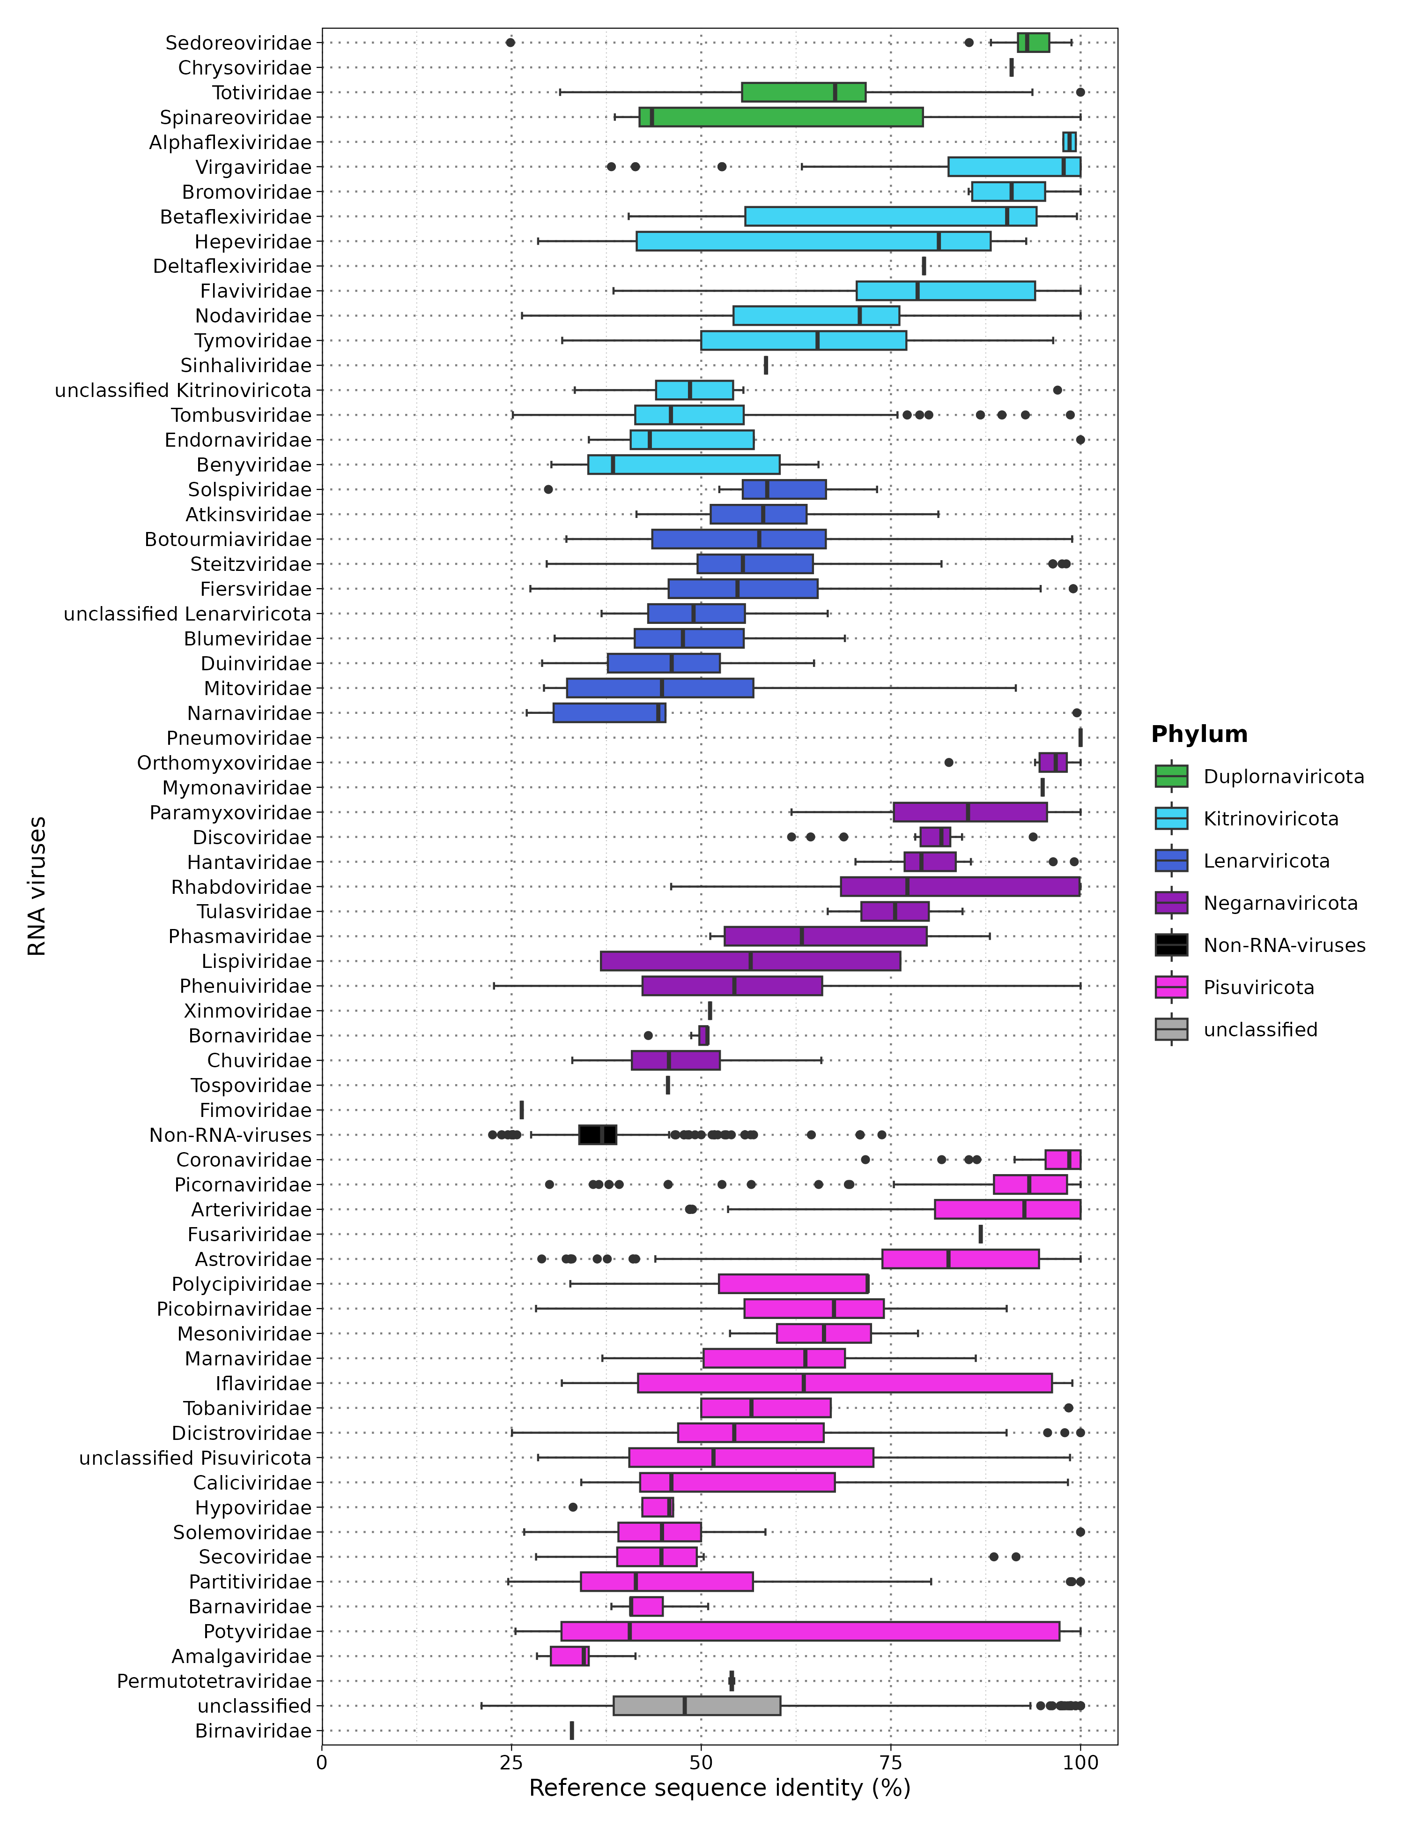
Results: Mammalian - Sequence identity
80.59% of viral contigs (5,004/6,209) had <90% protein sequence identity with the closest known virus.
Notes:
Next, I want to see how many novel sequences were identified.
- We define novel as having a sequence identity below 90 % to the closest virus in the taxonomy annotation.
- Majority of viral contigs are novel with 80%
Majority of median values between 40 – 80 % sequence identity
- However

Slide 22
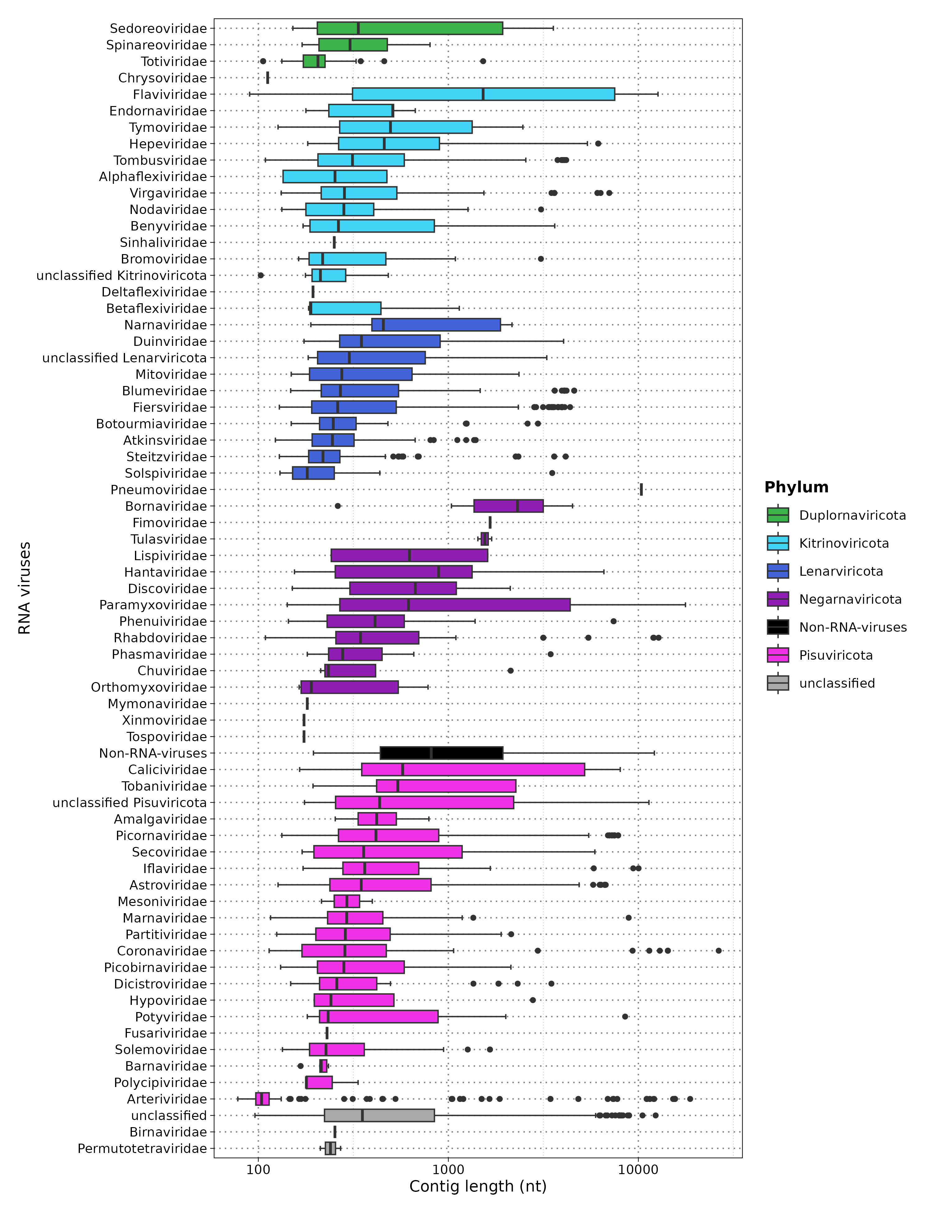
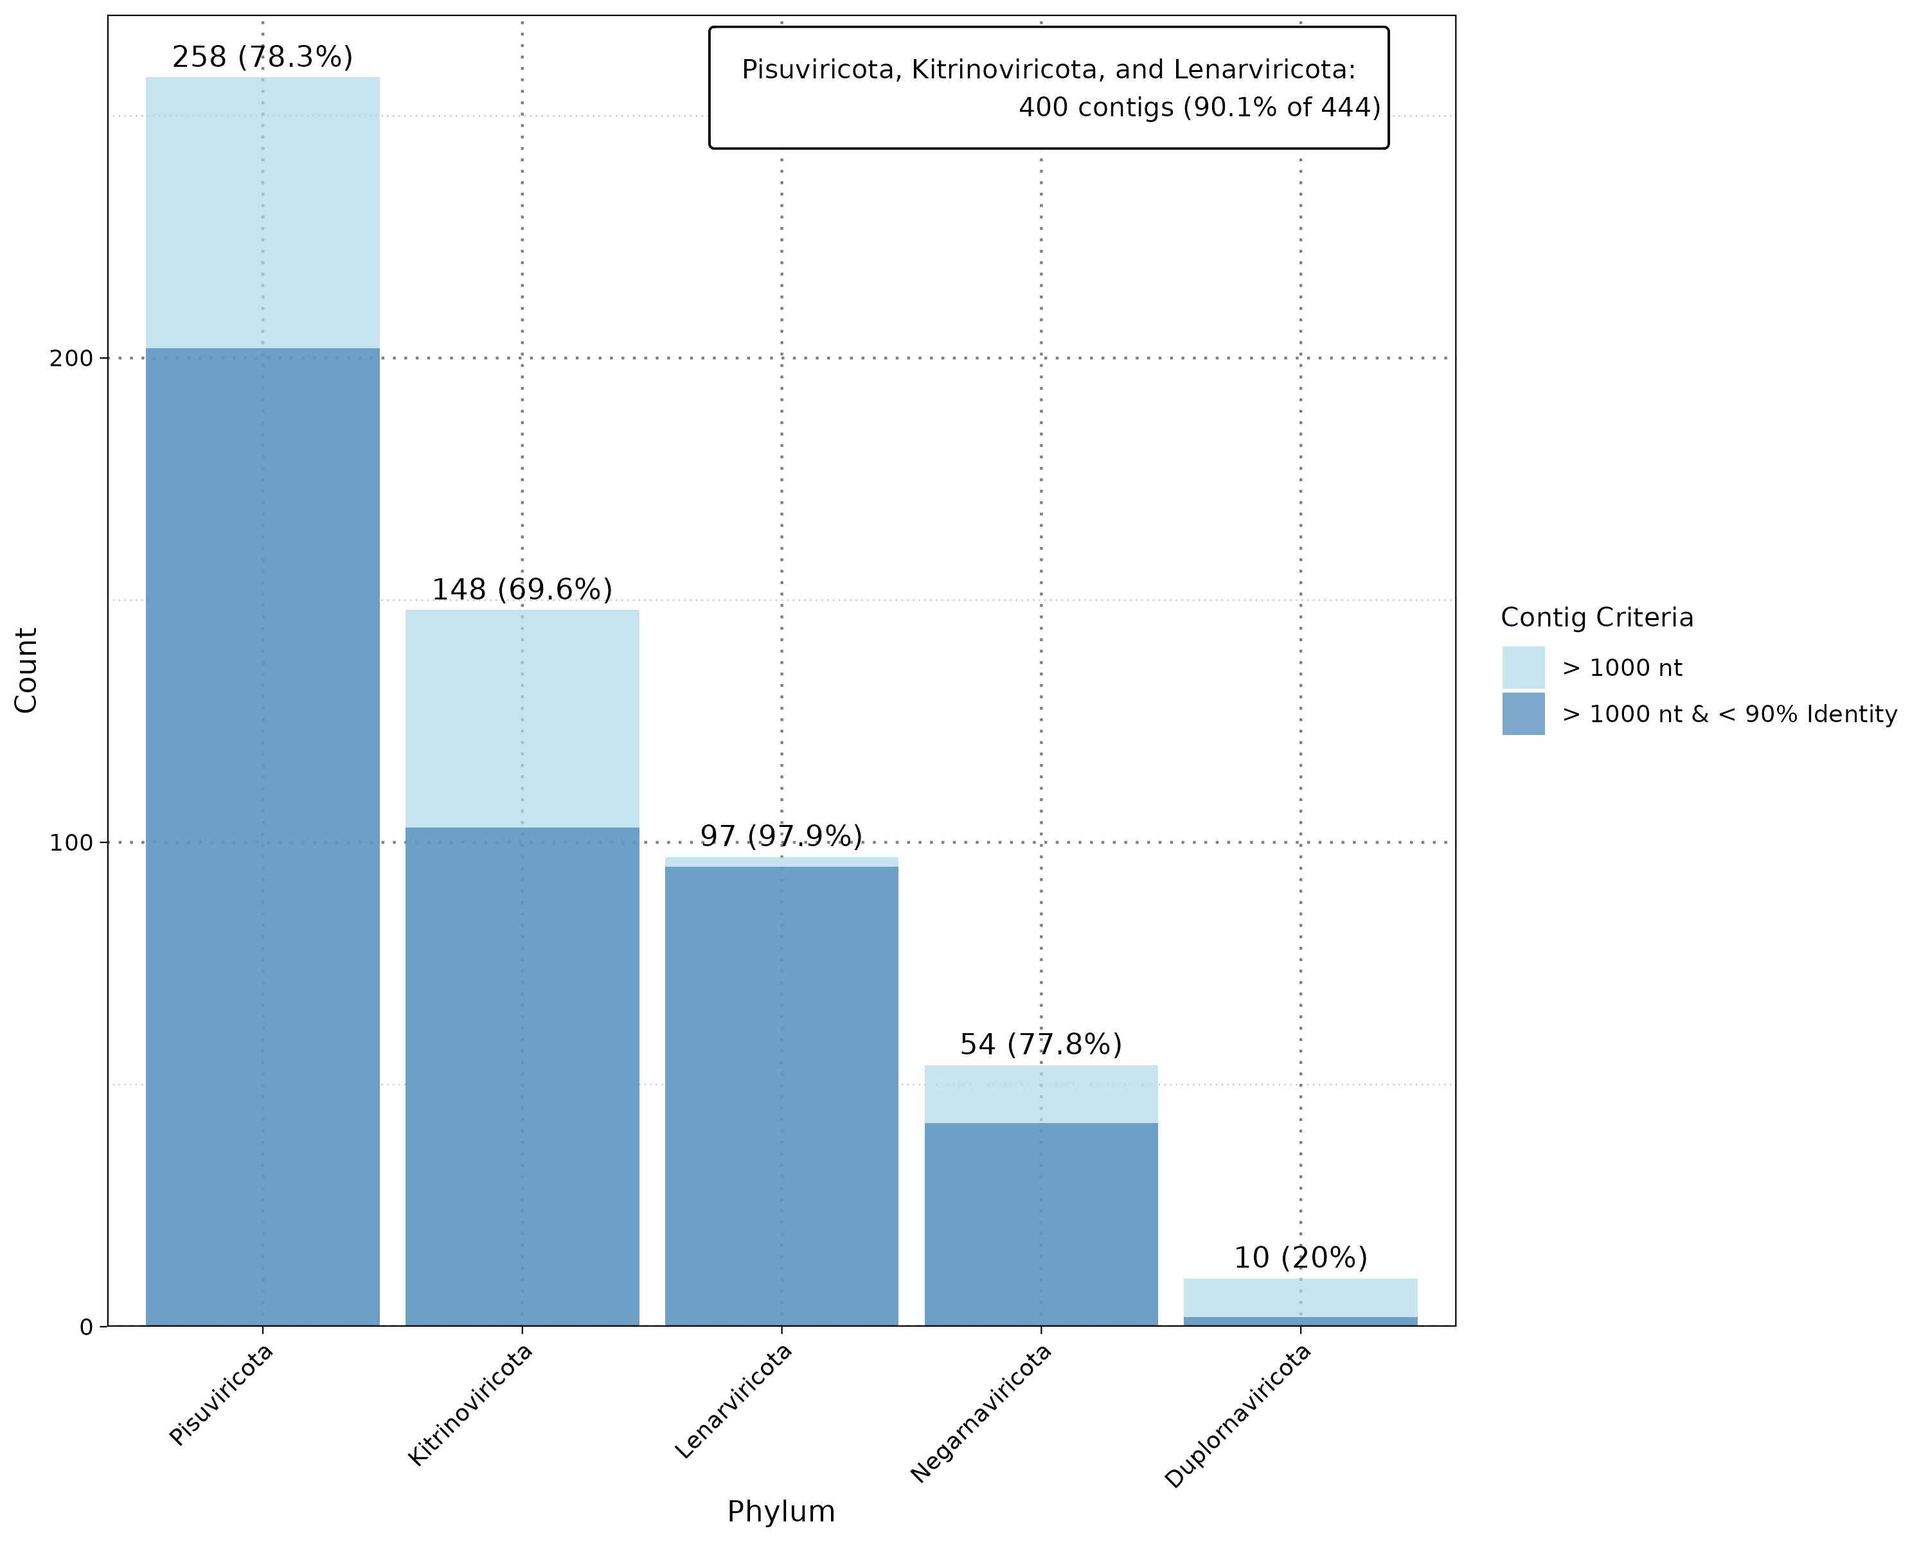
Results: Mammalian - Contig Length
Overall Summary:
Total Contigs: 1,225 contigs >1,000 nt.
Novel Contigs:
Total: 444 total >1,000 nt.
Median Length: 2,619 nt (range: 1,001–26,479 nt).
Notes:
However the majority of contigs are short.
With only 1225 contigs being longer than 1000 nt.
Thats important because weare interested in viral sequences containing ideally coding complete genomes.
Here we identify mostly partial genomes.
With 444 being both novel and long with a range of 1000 -26000
Again we see here that the 3 phyla dominate the long and novel long contigs
With 90% of novel and long contigs containg contigs aligning to those 3 phyla.

Slide 23
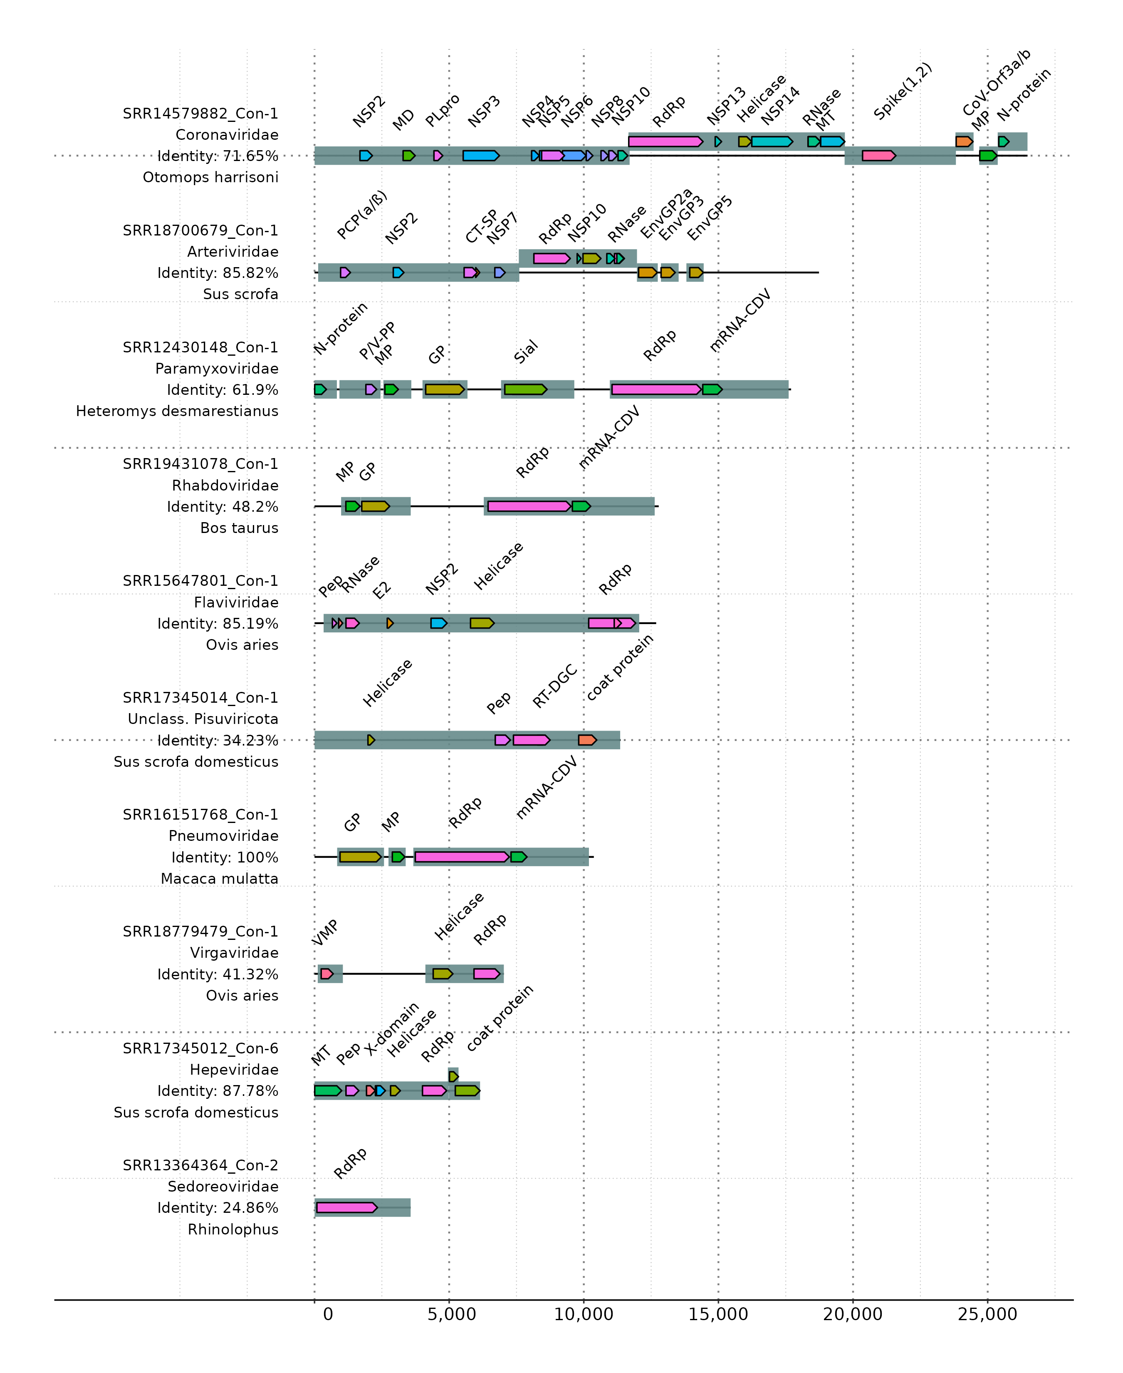
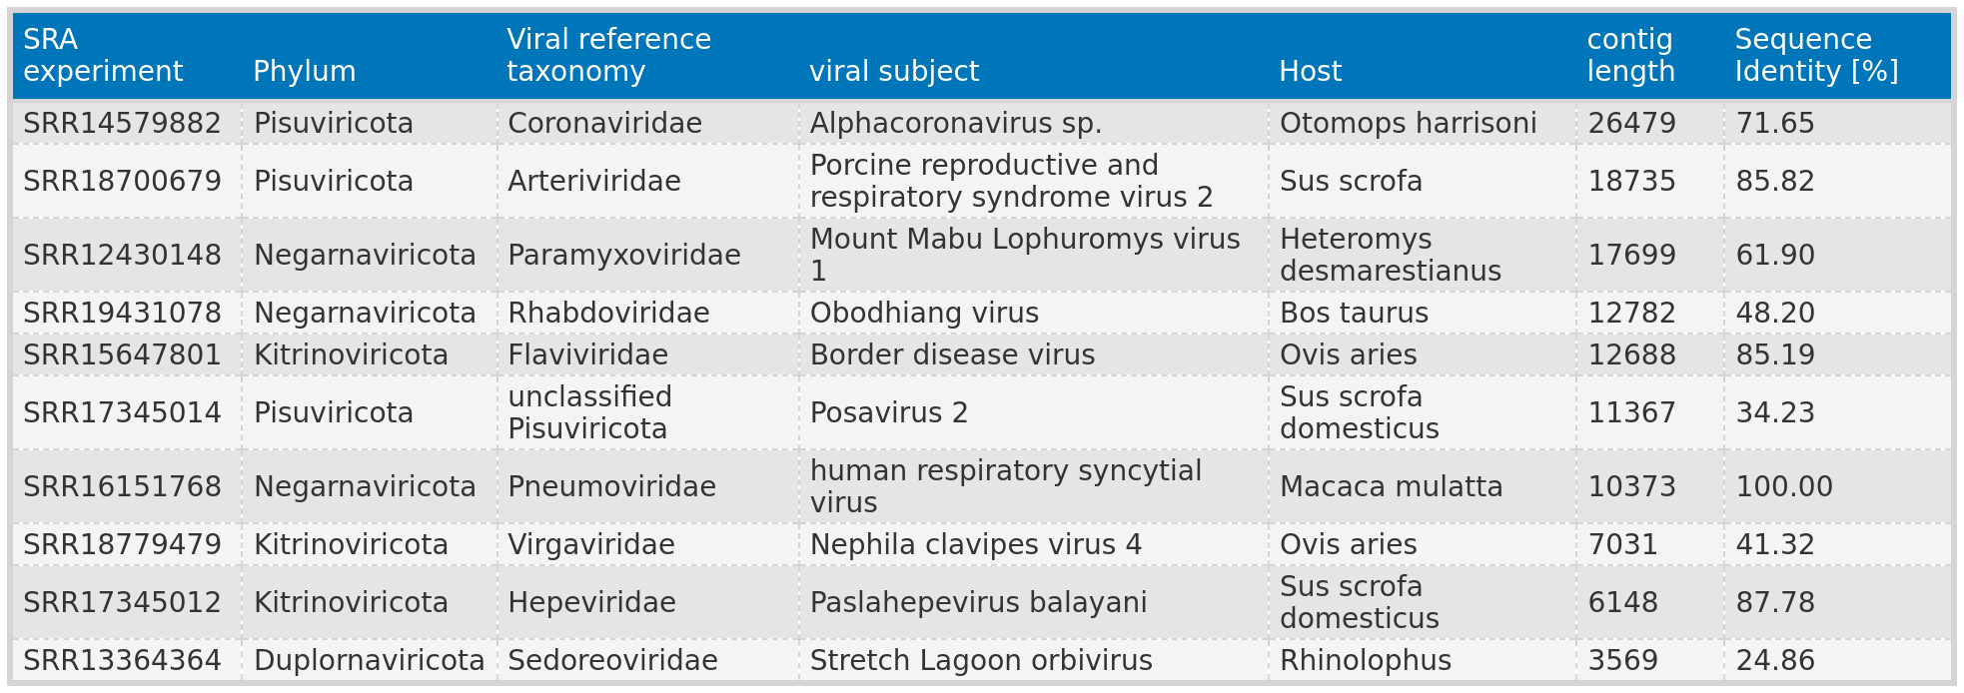
Results: Mammalian - Functional annotation
of the top ten largest contigs
SRR12430148_con-1: Identified RNA editing site (TTAAAAAAGGCA), similar to Mount Mabu Lophuromys virus 1¹.
Matches conserved motif (YTAAAARRGGCA) found in Henipavirus, Morbillivirus, and Jeilongvirus genera.
¹Vanmechelen B, Bletsa M, Laenen L, et al. Discovery and genome characterization of three new Jeilongviruses, a lineage of paramyxoviruses characterized by their unique membrane proteins. BMC Genomics. 2018;19(1):617. doi:10.1186/s12864-018-4995-0
Notes:
Next, I took the top 10 longest contig from different phyla and performed functional annotation.
We can see that we can identify the RNA polymerase in each contigs. But we also find more.
For example. The longest contig aligned to an alphacoronavirus found in bats.
Here I identified a novel corona sequence with the typical open reading frames and expected protein domains.
And for the third longest contig we Identified not only the typical ORFS and domains,
But on a sequence level I also found the characteristic RNA editing site typical of the virus.
That means we can identify viral sequences with VirusHunterGatherer and we can identify close to coding complete sequences.

Slide 24
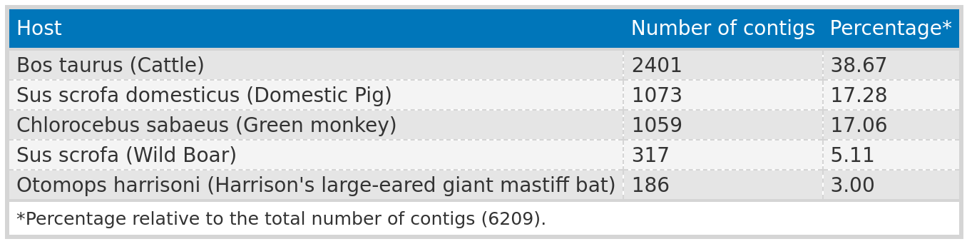
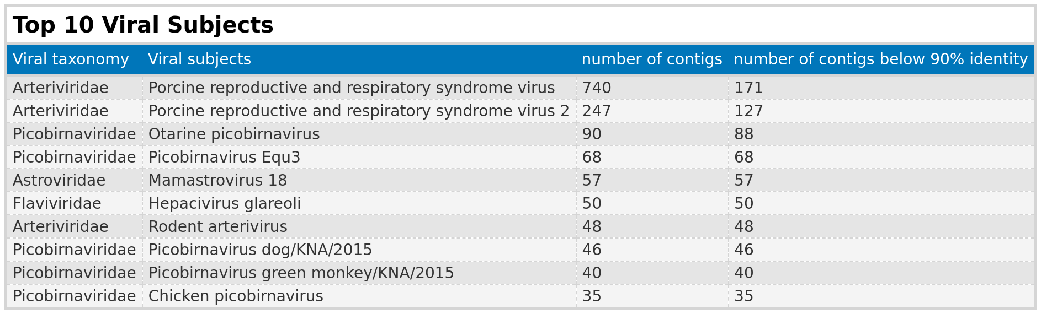
Results: Mammalian - Subjects
PRRSV: 981 contigs from study ERP130049, using African green monkey (Chlorocebus sabaeus) cell lines from fetal kidney tissue—not natural infections.
Majority of hosts: Farm animals;
! dairy products but listing cattle (Bos taurus) as the host.
Notes:
I mentioned that 3 phyla are dominating the results.
I was curious and looked at the host distribution and I dentified that most hosts were farm animals, followed by bats and rodents.
And if we look at the viral subjects with the most hits, we can see that a lot of the viral contigs are associated with farm animals and belong to those 3 phyla.
So the dominance of those three phyla is tight to the overrepresntation of farm hosts in the data.
Interesting is however the green monkey host.
They originat from 1 study, which infected green monkey derived cells with the PRRSV, a virus typially found in pigs.
Also interesting is that a chunk of cattle data analyzed not cattle but milk products.
So wee see that we are getting a mix of natural host, cell lines and by products of the host.

Slide 25
Results:Mammalian - Summary
RNA virus contig assembly results
Assembled 6,209 contigs from 332 samples aligned to RNA virus families.
Cross-finding: Identified 11 non-RNA virus families with lower E-values than RNA viruses.
Contig characteristics
80.59% (5,004/6,209) of viral contigs exhibited <90% protein sequence identity with the closest known virus.
19.72% (1,225) of contigs were >1,000 nt across all phyla.
444 contigs had a length >1,000 nt and sequence identity <90%.
Dominant phyla
Top three phyla: Lenarviricota, Kitrinoviricota, and Pisuviricota (most prevalent).
Predominantly associated with farm animal viruses.
Functional annotation
Consistent identification of RNA-dependent RNA polymerase (RdRp), used for screening.
Many contigs revealed characteristic protein domains specific to their virus families, including an RNA editing site.
Notable findings
Detected viruses present in dairy products and fetal kidney cell lines from African green monkeys.

Slide 26
Conclusion and Outlook

Slide 27
Conclusion
Taubert – liver sequencing data:
Analysis complete with only a small portion of files returning assembled contigs.
No conclusive evidence links viral infections to liver rejection.
Mammalian sequencing data:
6,209 contigs.
444 long and novel contigs.
characteristic protein domains specific to their virus families.
known virus families associated with farm animals.
Virusparies:
R package
Tool for visualizing or summarizing results → Reports.
Notes:
Shorten it.

Slide 28
Outlook
Contigs from mammalian sequencing data as future resource:
Contigs as a valuable resource for the Computational Virology Research Groups current and future projects.
Li Chuin Chong's research on predicting the spillover risk of RNA viruses.
Curation:
Eliminate unwanted contigs.
Tracing the samples back to the original work to determine the virus's source.
Phylogenetic analysis:
Transition from basic taxonomic annotations to detailed classification.
Notes:
Stress the last point. I assembled contigs because they might help existing and future projects.

Slide 29
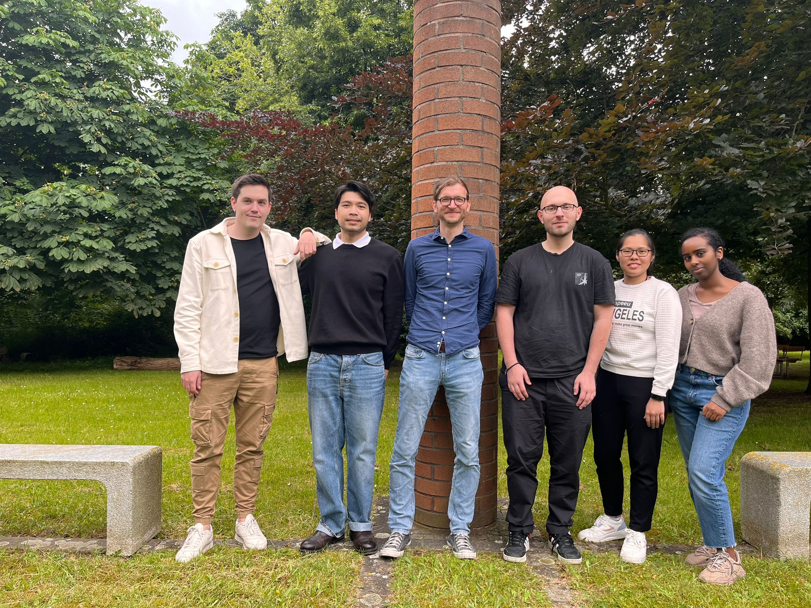
Acknowledgement
First supervisor:
Prof. Dr. Chris Lauber.
Second supervisor:
Prof. Dr. Helena U. Zacharias.
Li Chuin Chong.
Taubert – Department of Gastroenterology,Hepatology, Infectious Diseases and Endocrinology.
Computational Virology Research Group.
Institute for Experimental Virology.
Scientific community.

Slide 30
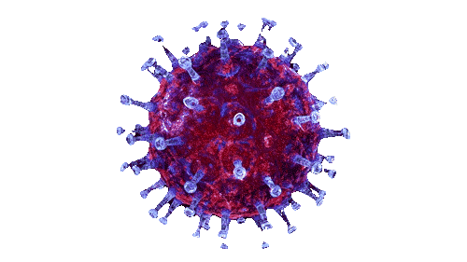
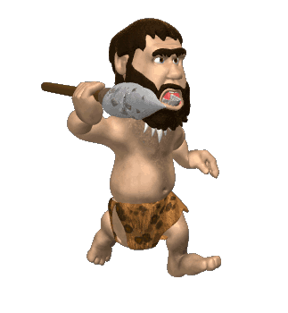
Thank you for listening! Any questions?

Slide 31
Results: Taubert
VirusGatherer
Liver sequencing data: 557 FASTQ files
VirusHunter
VirusGatherer

Slide 32
Results: Taubert
subjects

Slide 33



Schematic workflow of
VirusHunterGatherer pipeline
Taubert liver sequencing data
Mammalian sequencing data
SRA
Notes:
Mention, that VirusHunterGatherer was available to me. Meaning I apply it, while Virusparies was developed by me.

Slide 34
VirusHunterGatherer hittables
ViralRefSeq_taxonomy processed to extract virus family

Slide 35
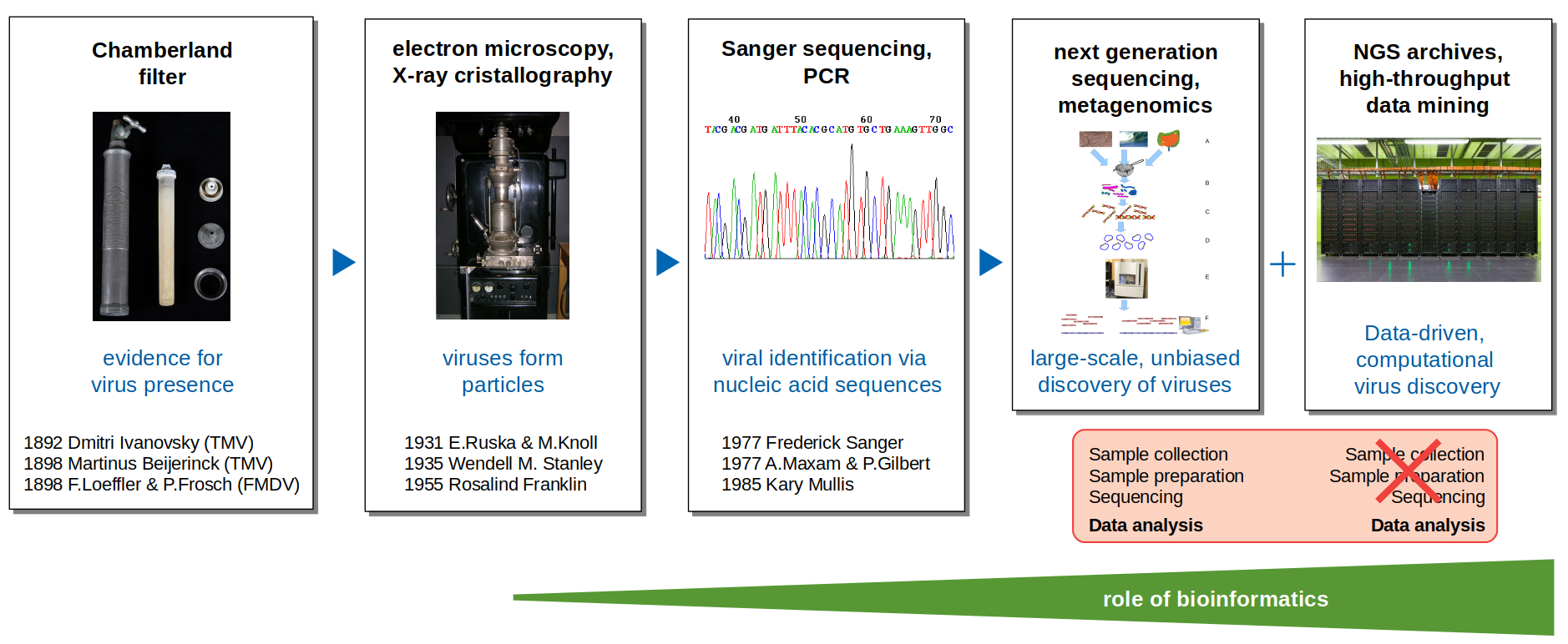
History of virus discovery
Image taken from Prof. Dr. Chris Lauber.
Notes:
Cut maybe this slide.

Slide 36
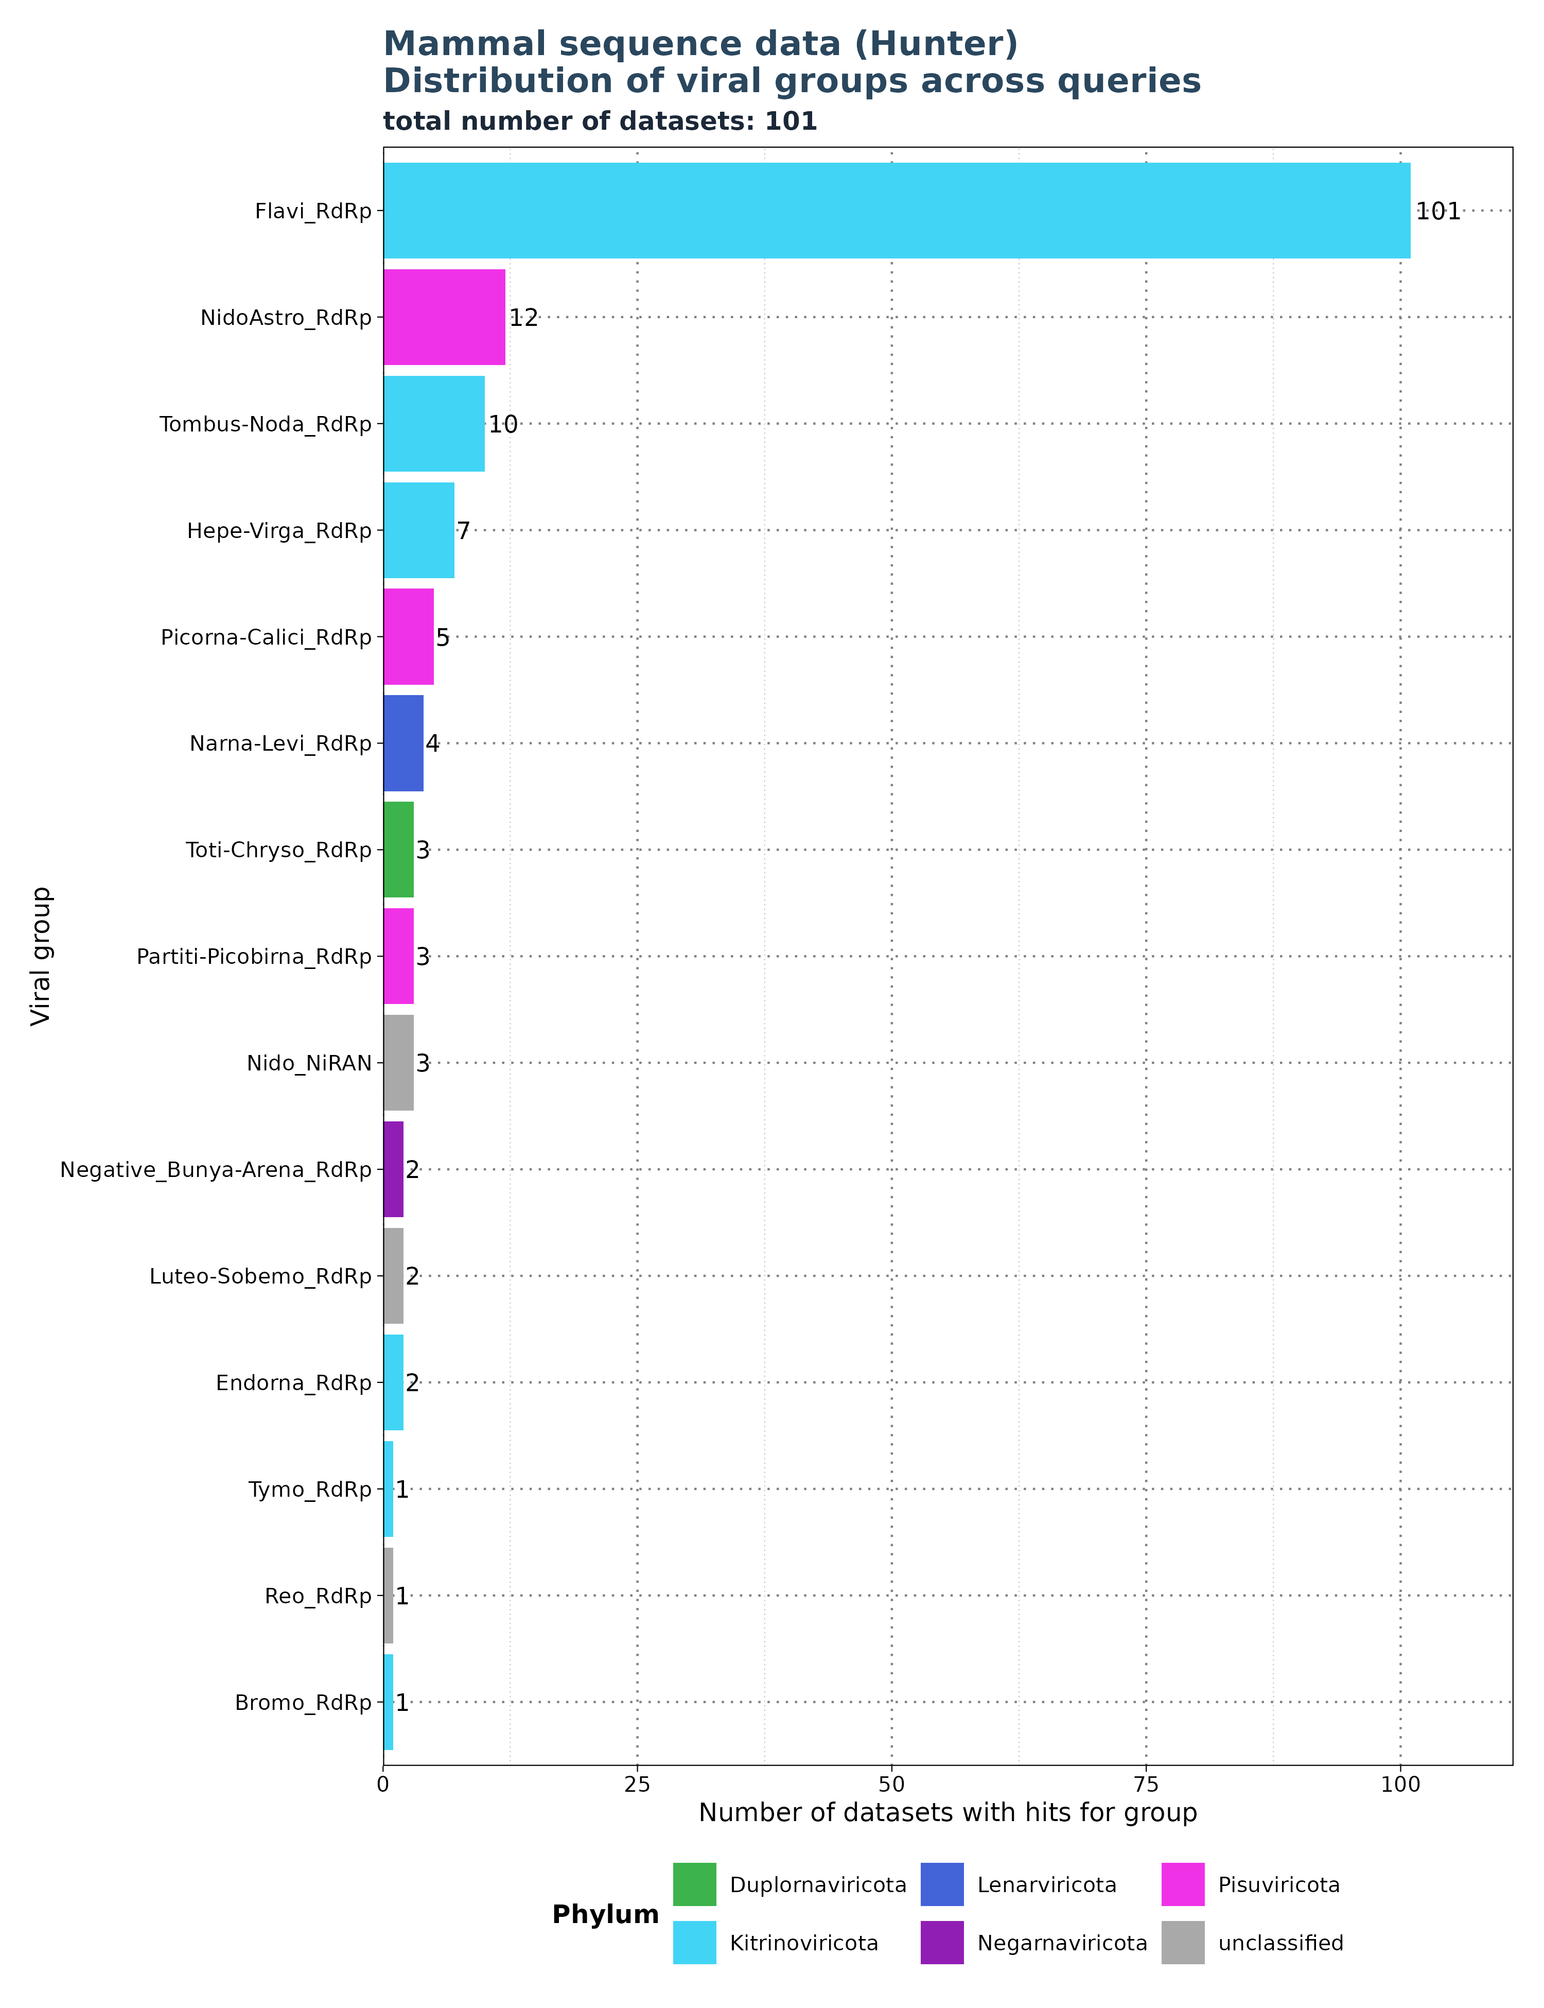
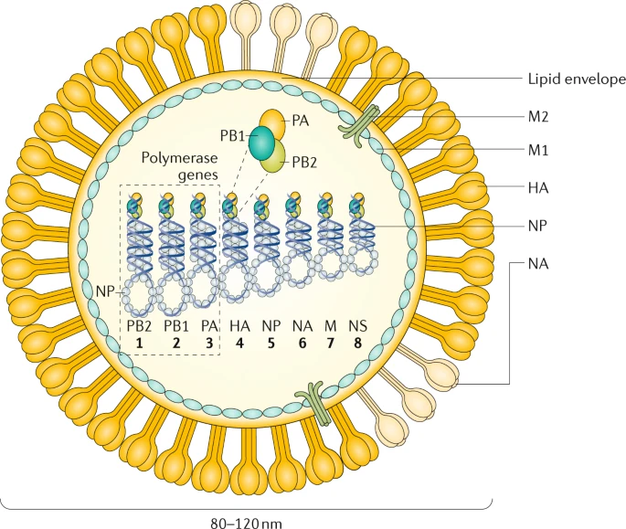
Limitations: Segmented viruses and specificity of profiles
Krammer, F., Smith, G.J.D., Fouchier, R.A.M. et al. Influenza. Nat Rev Dis Primers 4, 3 (2018). https://doi.org/10.1038/s41572-018-0002-y
Search for: Flavi_RdRp.

Slide 37
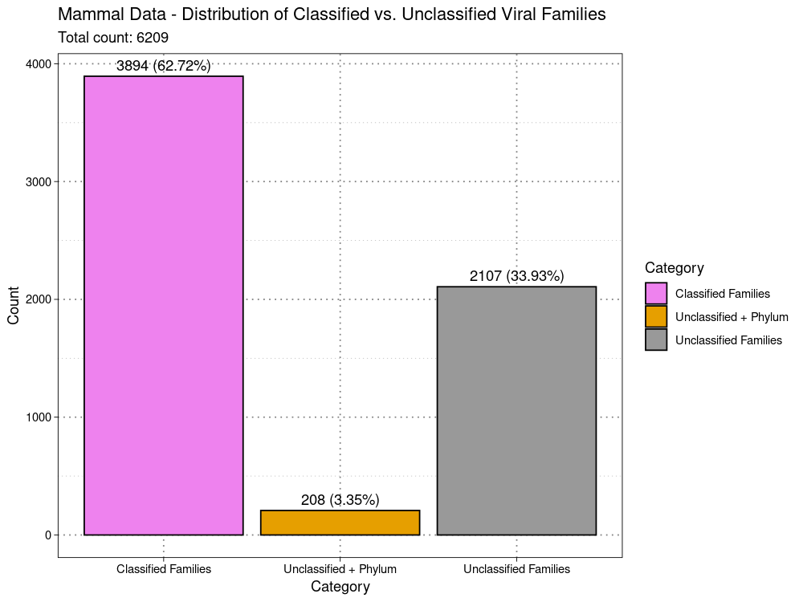
Limitations:
classified vs unclassified
Viral Family extracted from
ViralRefSeq_taxonomy column
ViralRefSeq_taxonomy:
taxid:1354498|Hepacivirus
colobi|Hepacivirus|Flaviviridae|Amarillovirales|Flasuviricetes|Kitrinoviricota|Orthorn
avirae|Riboviria

Slide 38
Extrapolated viral diversity estimates from a bat and primate species to assess emerging human threats.
These represent the only published estimates of unknown viral diversity in vertebrate hosts.
99% of viral zoonoses originate from non-human mammals or in birds → 69 mammal and 8 bird out of 78.
Viruses that originate in or have that originate in those hosts
Estimates of viral diversity for the bat Pteropus giganteus are based
on repeated sampling of individuals of this species and viral discovery using PCR with degenerate family-level primers targeting 9 viral genera or families, all known to contain zoonoses.
Estimates of viral diversity for the rhesus macaque Macaca mulatta targeted 21 viral families by PCR, as well as high-throughput sequencing (HTS).
Average of 11.58 viruses/family (SE: 6.74),indicating that the average viral family has between 4.84 and 18.32 viral species (skewed by Picobirnoviruses).
Median is 2.5 species/family.
For the Global Virome Project (GVP), 25 viral families with high zoonotic potential were targeted, estimating a global mammalian viral richness of 1.53 million species (SE: 640k-2.42M). Additionally, avian influenza viral richness was estimated at 137k species, leading to a total global estimate of 1.67 million viral species from zoonotic families.

Slide 39
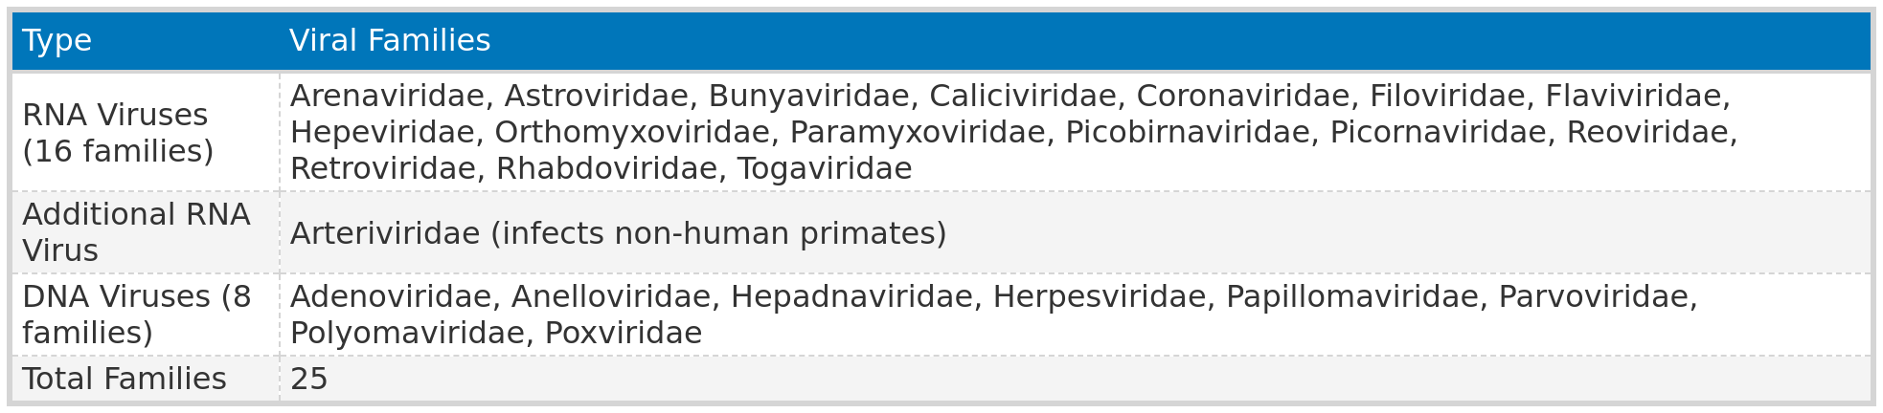
25 families * 11.58 species/family * 5,291 (number of mammalian species) = 1.5 mil
Orthomyxoviridae (Influenza) * 11.58 * 11,862 = 137,362.96

Slide 40
“We therefore multiply the per-viral family mean of 11.58 species by 25 (see specific viral families listed below) to give an estimate of the total viral diversity within all 25 viral families that have high zoonotic potential as 289.5 (se 121.0 - 458.0) for each mammalian host species. Given that there
are 5,291 known mammal species (21) (excluding marine mammals which have limited
contact with humans relative to terrestrial and volant mammals) we estimate global
mammalian viral richness in our 25 target viral families at 1,531,745 (se 640,211 -
2,423,278). In addition, influenza viruses derived from mammals and birds represent a
significant public health threat globally. Therefore, we used the mean viral diversity per
viral family in mammal hosts (11.58), and assumed that this may also represent the
average per-host species viral diversity for influenza viruses (Orthomyxoviridae) in each
of the 11,862 known bird species bird species (22). This gives an estimated avian
influenza viral richness of 137,362.96 (se 57,412 - 217,312), and a total global richness
of viral species from families with high zoonotic potential of around 1,669,106.”

Slide 41
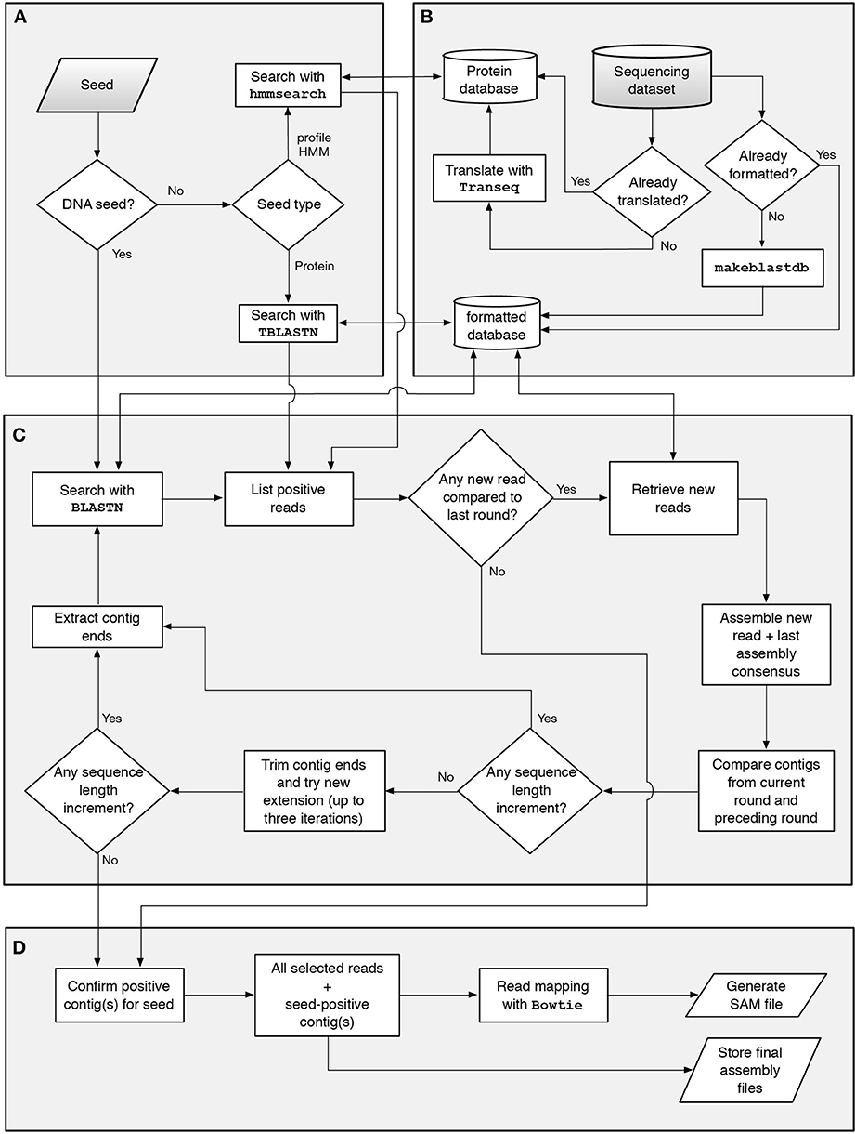
Genseed and existing assemblers
Genseed:
Seed-driven progressive assembler.
Efficiently reconstructs all genomes in a sample.
CAP3, Newbler, Velvet, SOAPdenovo,AbySS ….
Why not use common (de novo) assemblers?
Existing assemblers require either
A lot of memory.
A lot of time.
GenSeed runs in multiple steps with only a few reads.
De novo designed for single organisms
- closely related organisms create chimeric sequences (viruses carry host sequences).
Uneven distribution.
Problems with highly variable sequences.
Cannot efficiently reconstruct all genomes in a sample.

Slide 42
Why was filter 2 not used in VirusHunter?
- Problem with the “Anelloviridae” test data
- Some expected hits did not appear.
- Hepatitis B hits did not appear – problem for taubert dataset.
Reason:
Database in filter against host “contaminants” contains viral sequences falsely marked as hypothetical proteins of bacteria = get removed.
Solution:
- Update Blast database.
- Make filter 2 optional.
- Do not consider any hits against "hypothetical protein" entries in filter 2.

Slide 43
RNA viruses
RNA-dependent RNA polymerase (RdRp) domains
hepatitis delta antigen (HDAg)
RNA-dependent RNA-polymerase-associated Nucleotidyltransferase
(NiRAN)
Large DNA viruses
major capsid protein (MCP) domains + others
Small DNA viruses
replication initiator protein (Rep) domains

Slide 44
Preprocessing
Fastp -Trimming of sequencing adapters and removal of low-quality bases.
Adapter sequences were auto detected and removed.
Reads shorter than 15 bases or containing more than 5 ‘N’ bases were discarded
Seqtk - convert to FASTA format.
Transeq – translate sequences into protein sequences across six reading frames.
Hmmsearch – homology search
Size of target database for E-value calculation: 6X number of reads.
- Accounting for each reading frame.
E-value of 10 for reporting.
If the total number of hits met or exceeded a threshold of two, or if the globally best E-value was below 0.01, the hits were considered significant.

Slide 45
Vsearch - removing sequences that had identical length and
nucleotide content.
CAP3 – microcontigs.
Only those sequences that had a minimum overlap length of
20 nucleotides and a maximum overhang percentage length of 75 % were
considered. The overhang percentage is calculated by dividing the total length of all overhangs by the length of the overlap, then multiplying by 100.
BLASTN – contaminant - ubiquitin sequences
Any matches with an E-value above 1e-4 were excluded.
BLASTX – translate nucleotide to protein and compare it to protein database.
TBLASTX – compare translated sequence against another translated sequence.

Slide 46
Gatherer
Fastp – processing
CAP3 as assembler.
Seeds - considering only sequences with an overhang percentage of 99% or less,
and a minimum overlap length of 20 bases for assembly.
maximum of 100 iterations.
Contig ends with a length of 30 were used for further assembly.
maximum contig length was set to 50.000 nt.
For CAP3, the minimum percentage identity for an overlap was set to 85%, with the minimum overlap length required being 20 nucleotides.
Additionally, the maximum allowable overhang was set to 99%.
For the initial similarity search, BLASTN with an E-value cutoff of 1e-3, a percentage identity of 85%, and a word size of 7 was applied.
Lastly, the modified version of Genseed-HMM performed deduplication in each iteration to decrease CAP3 assembly time.

